Slide 1
Algorithm for Treatment of T2DM to Initiate or Intensify Injectable Therapy in Iraq
Initiate or intensify injectable therapy
HbA1c < 2% from target
HbA1c ≥ 2% from target
BMI ≤ 30
BMI > 30
BMI ≤ 30
BMI > 30
Basal insulin ⃰⃰⃰
& titration
GLP-RA ⃰⃰ ⃰⃰
or BI + GLP-1 RA ⃰ ⃰
(FRC or separately)
BI + GLP-1 RA ⃰ ⃰
(FRC or separately)
Or Premix agents♯
BI + GLP-1 RA ⃰ ⃰
(FRC or separately)
If HbA1c above Target
BI + GLP-1 RA ⃰ ⃰
(FRC preferably or separately)
If HbA1c above Target
BI + GLP-1 RA ⃰ ⃰ (BI max dose) + Rapid Acting Insulin
If HbA1c above Target
Basal +/ Bolus Insulin
OR
Premix insulin
Intensify insulin
⃰⃰ 2nd generation Basal Insulins are preferred over older generations
⃰ ⃰The choice of GLP-1 RA is based on patient-specific considerations, including established CVD, CKD, desired weight benefit, access and cost
♯ Complex insulin regimens (such as premix insulins) may be used as alternatives if other options are not accessible locally
HbA1c: Glycated Hemoglobin
BI: Basal Insulin
GLP-1 RA; Glucagon-like peptide-1 receptor agonists
BMI: Body Mass Index
FRC: Fixed Ratio Combination
Notes:
Iraqi consensus: Saab et al., Diabetes Therapy 2026; Iraqi Injectable Therapy Algorithm
Experts’ recommendations on injectable therapy use for T2D management
The expert EACG has developed practical recommendations on insulin initiation and titration for patients with T2DM in the Gulf region.
The expert’s recommendations and reflections include the real-world approach to PCPs, supported by ADA/EASD/IDF/NICE guidelines for insulin initiation, optimization, and maintenance in T2DM.
Second-generation insulin analogs (IGlar 300/ Degludec) offer significant clinical benefits compared to first-generation analogs in randomized clinical trials, meta-analyses, and real-world studies. Studies have demonstrated less hypoglycemia with second-generation BI analogs compared to first-generation BI analogs in older adults and those with renal impairment, obesity, and CV disease.

Slide 2
Disclaimer:
“For clinical decision support only. Physician judgment required.”
“Based on Iraqi Consensus 2026”
Notes:
Scenario
WHY (short CDS version)
Start BI: Mild hyperglycemia predominantly fasting
Start GLP‑1: Weight-driven insulin resistance
Start combo: High HbA1c requires dual control
Titrate BI: Basal not optimized
Add GLP‑1: PPG remains uncontrolled
Add prandial: Residual postprandial hyperglycemia
Basal–bolus: Multiple daily excursions
Premix: Simpler but less flexible option
Avoid premix: Requires fixed meal timing

Slide 3
One-Glance Decision Flow for Initiating and Intensifying Injectables
Clinical Situation | Recommended Strategy | Iraqi Practice Emphasis
HbA1c < 2% above target, BMI ≤30 | Basal insulin (2nd generation) + titration | Advance to BI + GLP-1 RA or FRC if not at target
HbA1c < 2% above target, BMI >30 | Basal insulin + GLP-1 RA | FRC preferred due to access and simplicity
HbA1c ≥ 2% above target (all BMI) | Initiate BI + GLP-1 RA | FRC positioned as default option
Persistent uncontrolled HbA1c | Further intensification | Add rapid-acting insulin; premix only if others unavailable
Notes:
✅ Core Takeaways
➡️ Start simple, intensify stepwise ➡️ Combine therapies early when needed ➡️ Optimize before escalating ➡️ Use GLP‑1 RA/FRC before complex insulin ➡️ Add RAI before basal‑bolus ➡️ Adapt to access limitations ➡️ Premix = alternative, not default

Slide 4
From “digital guideline” → “point‑of‑care decision engine”=‘’rule based clinical engine’’
Inputs: ✅ HbA1c gap vs target: < 2% above target ≥2% above target ✅ BMI: ≤ 30 >30 ✅ Meal pattern: Regular Irregular ✅ GLP‑1 RA accessible / tolerated Yes No ✅Current injectable regimen
Every scenario should follow this exact structure: 1. Title → “On [Therapy] – Inadequate Control” 2. Recommendation → What to optimize first 3. If HbA1c above target (next step) → Stepwise action 4. Key Considerations → Clinical + positioning

Slide 5
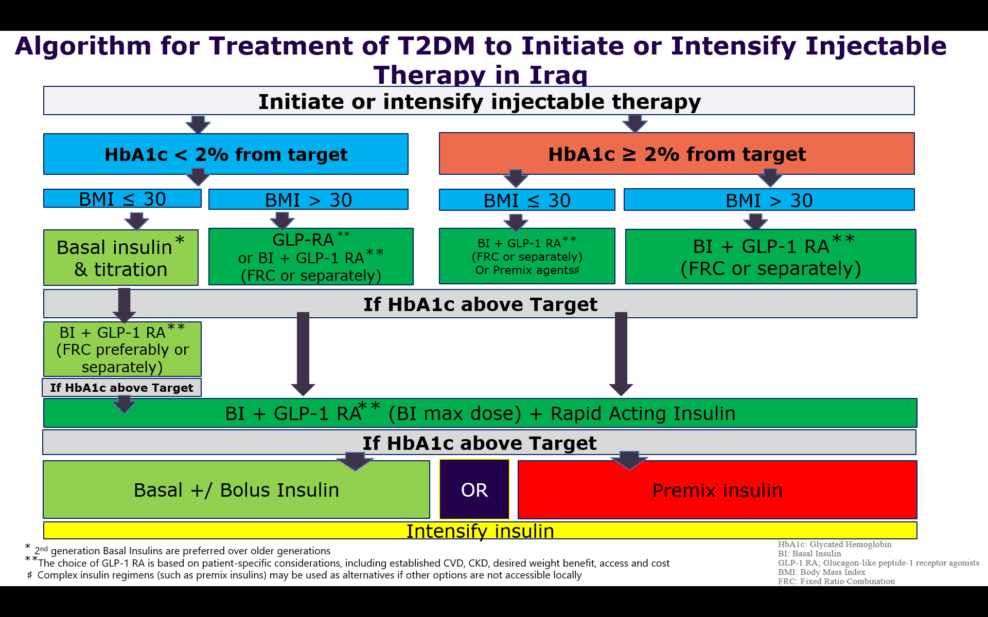
T2D Injectable Therapy CDS
1- None / first injectable selection
HbA1c < 2%
BMI ≤ 30
Notes:
scientifically precise + DSS-ready + minimal

Slide 6
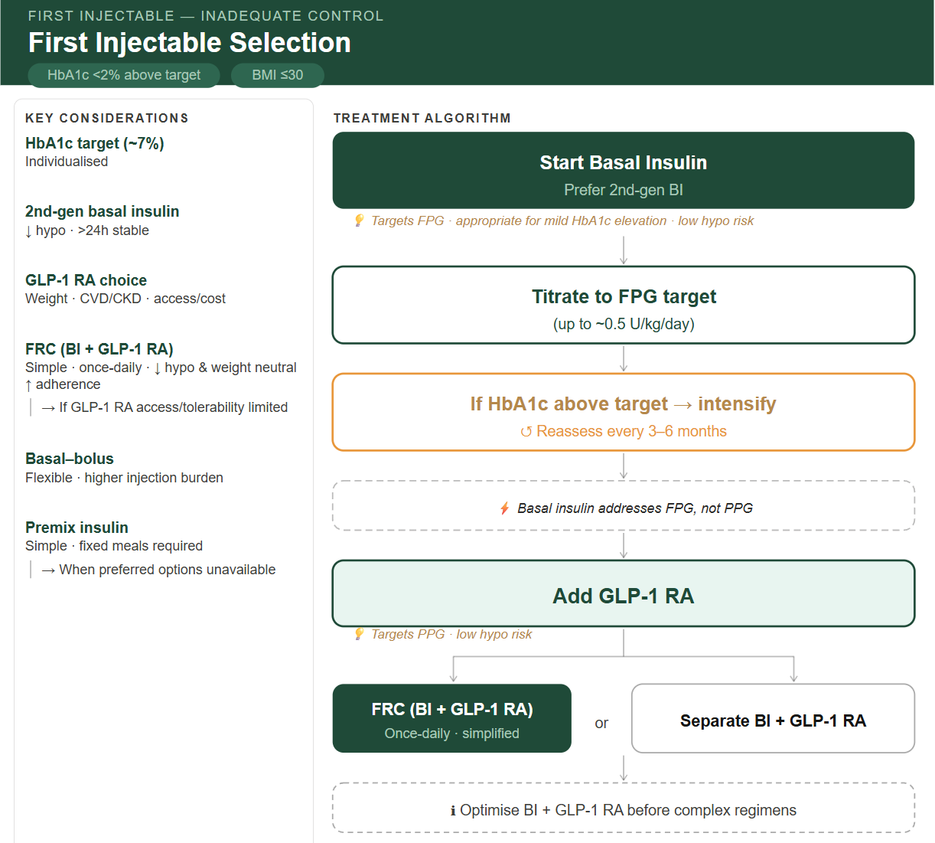
🧠 RECOMMENDATION
🟩 Start Basal Insulin
Prefer 2nd‑generation BI
💡 Targets FPG · appropriate for mild HbA1c elevation · low hypo risk
🟩 Titrate to FPG Target
(up to ~0.5 U/kg/day)
🟨 If HbA1c Above Target → Intensify
↺ Reassess every 3–6 months
⚡ Basal insulin addresses FPG, not PPG
🟩 Add GLP‑1 RA
💡 Targets PPG · low hypo risk
🟩 Choose Combination Strategy
🔗 FRC (BI + GLP‑1 RA)
Once daily · simplified
⚪ Separate BI + GLP‑1 RA
Optimize BI + GLP-1 RA before escalation to complex regimens
🔹 Key Considerations
🧪 HbA1c target (~7%): Individualized
💉 2nd‑gen basal insulin:↓ hypo · >24h stable
⚖️ GLP‑1 RA choice: → Weight · CVD/CKD · access/cost
🔗 FRC (BI + GLP‑1 RA): Simple · once daily · ↓ hypo · weight neutral · ↑ adherence → Consider when GLP‑1 RA access or tolerability is limited
🔄 Basal–bolus: Flexible · higher injection burden
⚖️ Premix insulin: Simple · fixed meals required → Alternative when preferred options are unavailable
None / first injectable selection - Inadequate Control
HbA1c <2% above target | BMI ≤30
Notes:
Reassess every 3–6 months

Slide 7
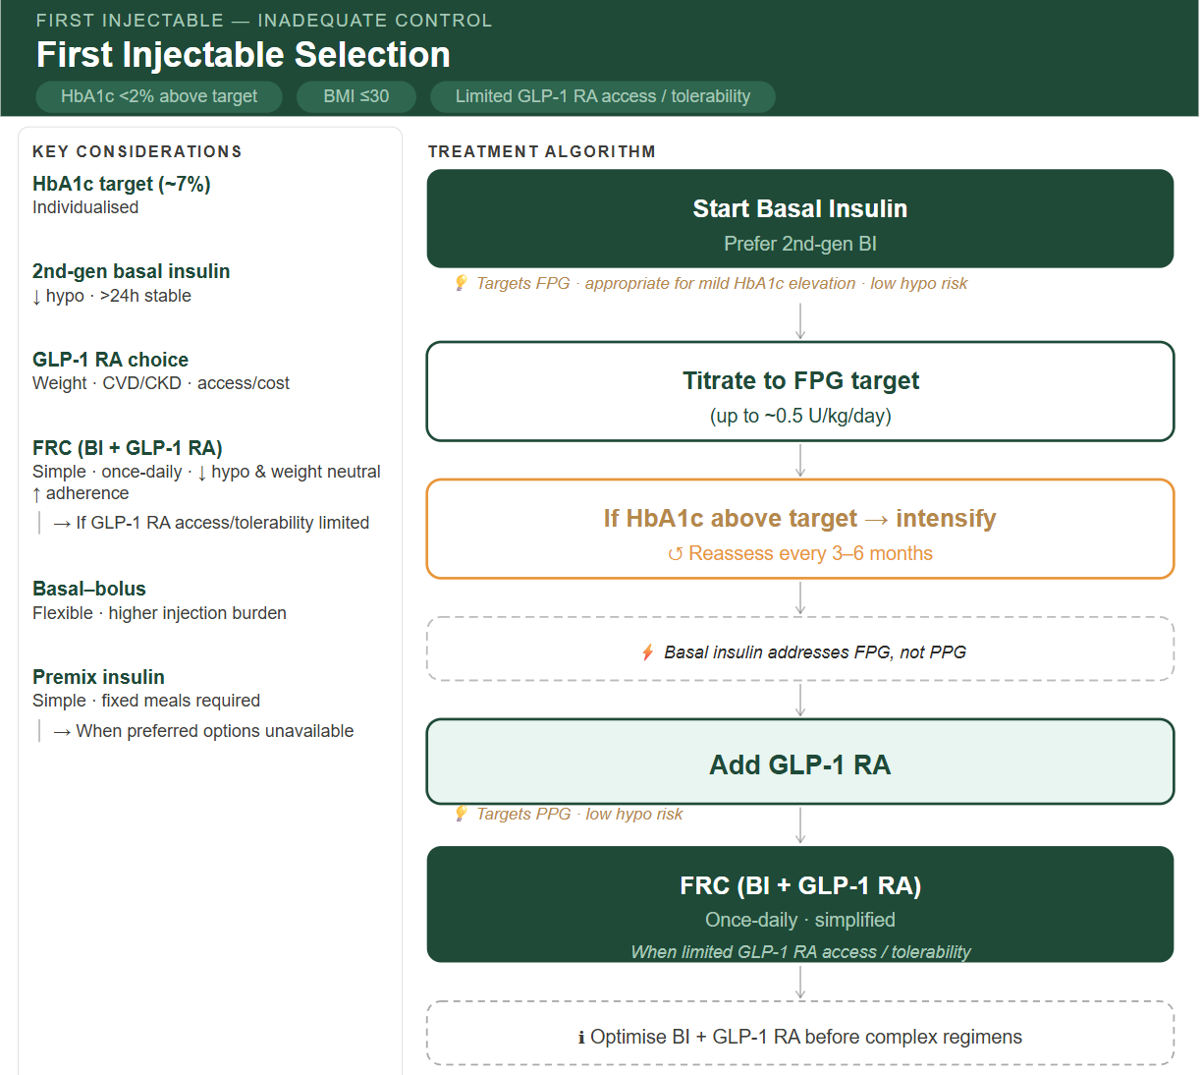
None / first injectable selection - Inadequate Control
HbA1c <2% above target | BMI ≤30 | Limited GLP-1 RA access / tolerability
🧠 RECOMMENDATION
🟩 Start Basal Insulin
Prefer 2nd‑generation BI
💡 Targets FPG · appropriate for mild HbA1c elevation · low hypo risk
🟩 Titrate to FPG Target
(up to ~0.5 U/kg/day)
🟨 If HbA1c Above Target → Intensify
↺ Reassess every 3–6 months
⚡ Basal insulin addresses FPG, not PPG
🟩 Add GLP‑1 RA
💡 Targets PPG · low hypo risk
🟩 Prefer FRC (BI + GLP‑1 RA) Once daily · simplified
(when limited GLP-1 RA access/ tolerability)
Optimize BI + GLP-1 RA before escalation to complex regimens
🔹 Key Considerations
🧪 HbA1c target (~7%): Individualized
💉 2nd‑gen basal insulin:↓ hypo · >24h stable
⚖️ GLP‑1 RA choice: → Weight · CVD/CKD · access/cost
🔗 FRC (BI + GLP‑1 RA): Simple · once daily · ↓ hypo · weight neutral · ↑ adherence → Consider when GLP‑1 RA access or tolerability is limited
🔄 Basal–bolus: Flexible · higher injection burden
⚖️ Premix insulin: Simple · fixed meals required → Alternative when preferred options are unavailable
Notes:
WHY
HbA1c <2% above target → BMI-driven decision
BMI ≤ 30 ➔ Basal-first strategy
Stepwise intensification preferred

Slide 8
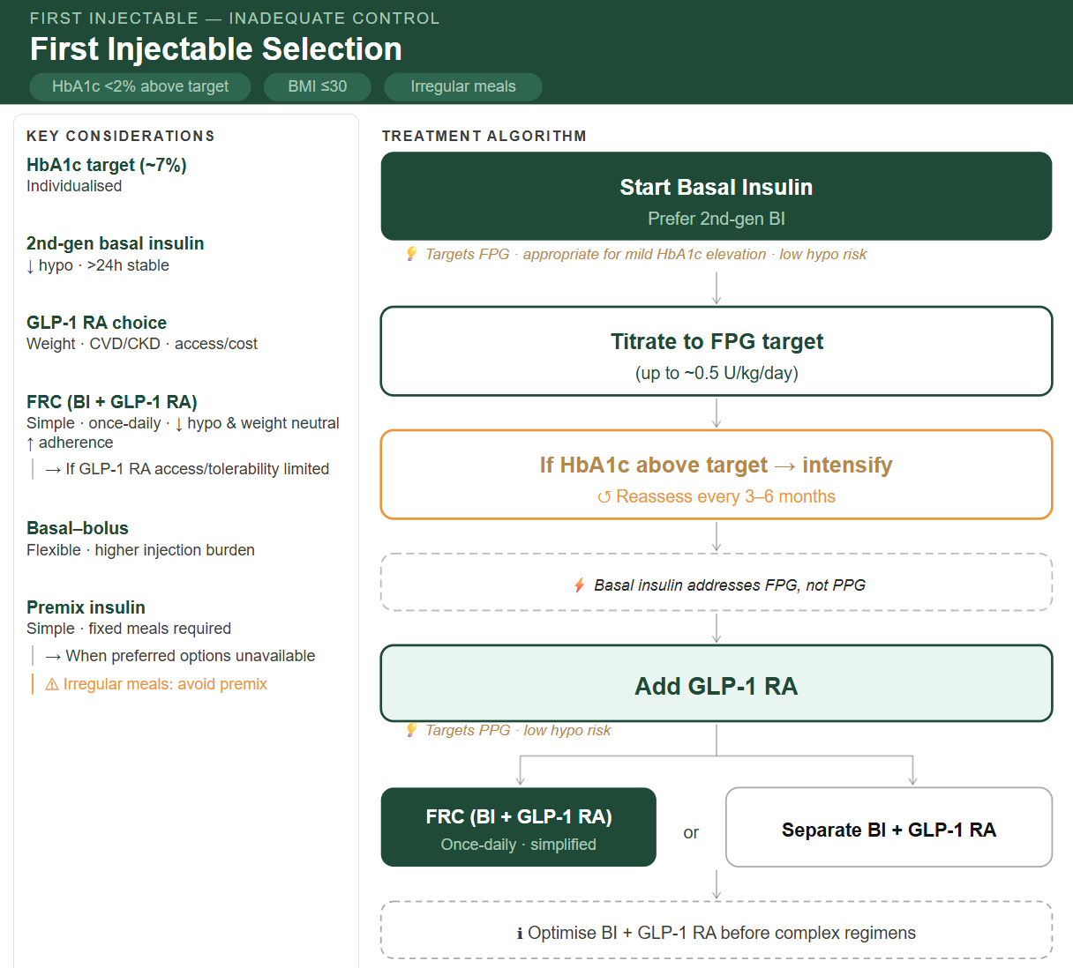
🧠 RECOMMENDATION
🟩 Start Basal Insulin
Prefer 2nd‑generation BI
💡 Targets FPG · appropriate for mild HbA1c elevation · low hypo risk
🟩 Titrate to FPG Target
(up to ~0.5 U/kg/day)
🟨 If HbA1c Above Target → Intensify
↺ Reassess every 3–6 months
⚡ Basal insulin addresses FPG, not PPG
🟩 Add GLP‑1 RA
💡 Targets PPG · low hypo risk
🟩 Choose Combination Strategy
🔗 FRC (BI + GLP‑1 RA)
Once daily · simplified
⚪ Separate BI + GLP‑1 RA
Optimize BI + GLP-1 RA before escalation to complex regimens
🔹 Key Considerations
🧪 HbA1c target (~7%): Individualized
💉 2nd‑gen basal insulin:↓ hypo · >24h stable
⚖️ GLP‑1 RA choice: → Weight · CVD/CKD · access/cost
🔗 FRC (BI + GLP‑1 RA): Simple · once daily · ↓ hypo · weight neutral · ↑ adherence → Consider when GLP‑1 RA access or tolerability is limited
🔄 Basal–bolus: Flexible · higher injection burden
⚖️ Premix insulin: Simple · fixed meals required → Alternative when preferred options are unavailable
⚠ Irregular meals: avoid premix
None / first injectable selection - Inadequate Control
HbA1c <2% above target | BMI ≤30 | irregular meals
Notes:
Reassess every 3–6 months

Slide 9
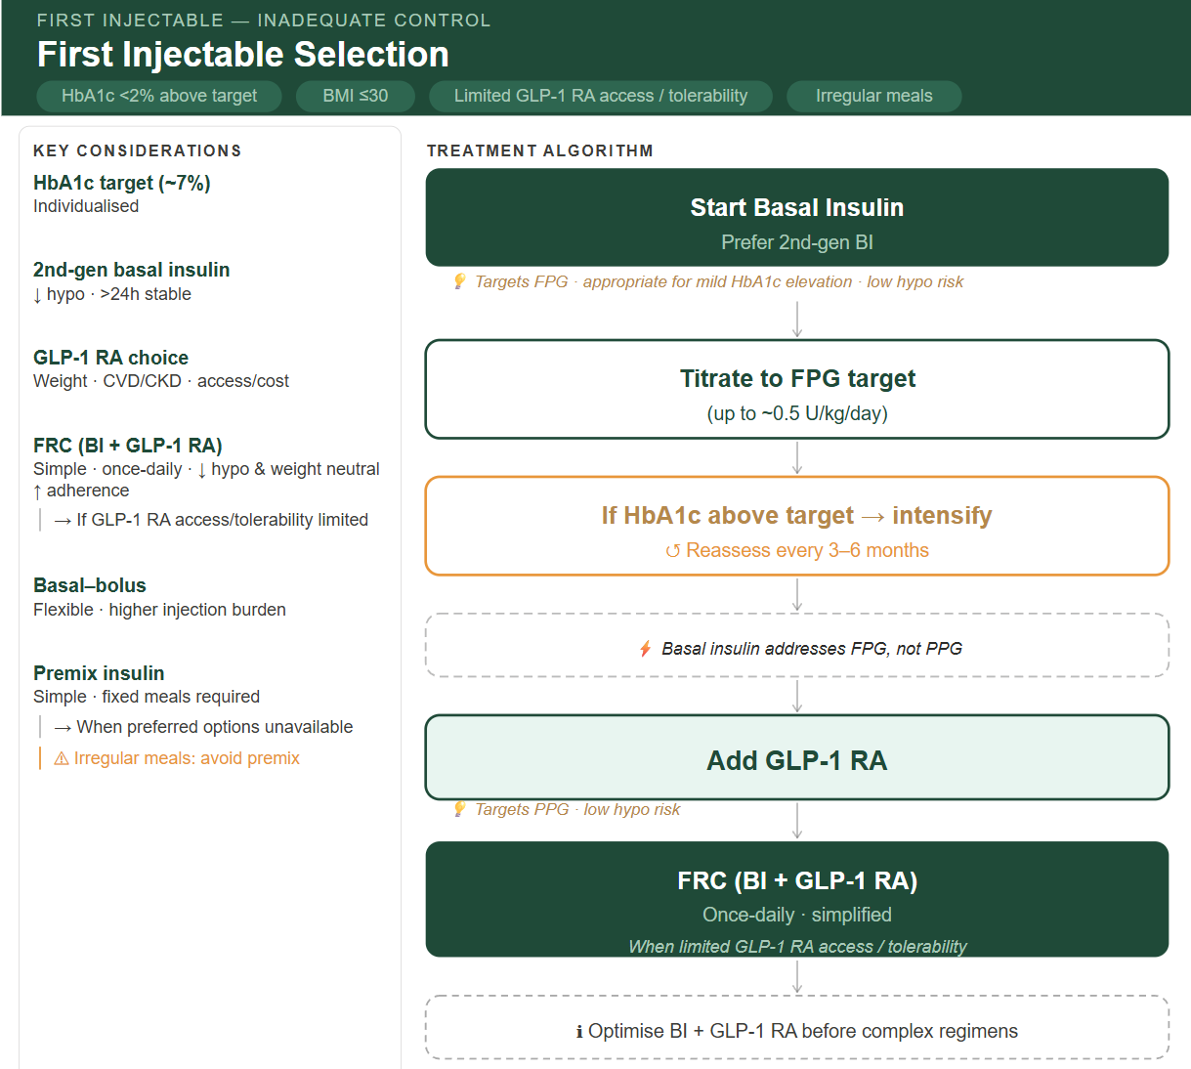
None / first injectable selection - Inadequate Control
HbA1c <2% above target | BMI ≤30 | Limited GLP-1 RA access / tolerability & irregular meals
🧠 RECOMMENDATION
🟩 Start Basal Insulin
Prefer 2nd‑generation BI
💡 Targets FPG · appropriate for mild HbA1c elevation · low hypo risk
🟩 Titrate to FPG Target
(up to ~0.5 U/kg/day)
🟨 If HbA1c Above Target → Intensify
↺ Reassess every 3–6 months
⚡ Basal insulin addresses FPG, not PPG
🟩 Add GLP‑1 RA
💡 Targets PPG · low hypo risk
🟩 Prefer FRC (BI + GLP‑1 RA) Once daily · simplified
(when limited GLP-1 RA access/ tolerability)
Optimize BI + GLP-1 RA before escalation to complex regimens
🔹 Key Considerations
🧪 HbA1c target (~7%): Individualized
💉 2nd‑gen basal insulin:↓ hypo · >24h stable
⚖️ GLP‑1 RA choice: → Weight · CVD/CKD · access/cost
🔗 FRC (BI + GLP‑1 RA): Simple · once daily · ↓ hypo · weight neutral · ↑ adherence → Consider when GLP‑1 RA access or tolerability is limited
🔄 Basal–bolus: Flexible · higher injection burden
⚖️ Premix insulin: Simple · fixed meals required → Alternative when preferred options are unavailable
⚠ Irregular meals: avoid premix
Notes:
Clinical alignment, clarity, actionable

Slide 10
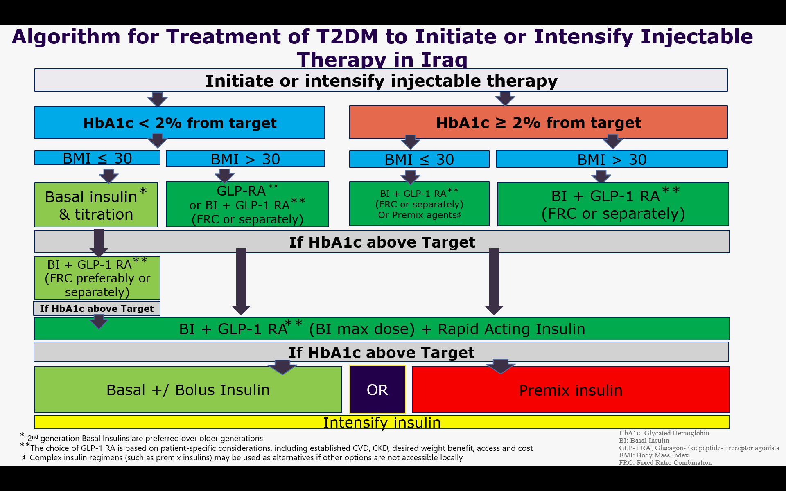
2- None / first injectable selection
HbA1c < 2%
BMI > 30

Slide 11
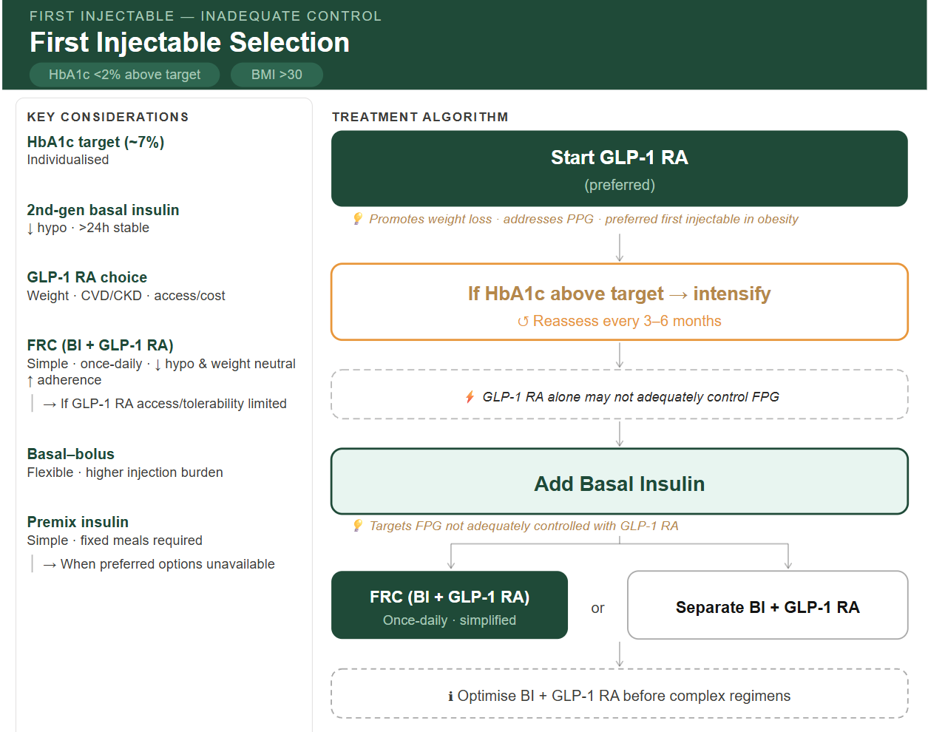
None / first injectable selection - Inadequate Control
HbA1c <2% above target | BMI >30
🧠 RECOMMENDATION
🟩 Start GLP‑1 RA (preferred)
💡 Promotes weight loss · addresses PPG · preferred first injectable in obesity
🟨 If HbA1c Above Target → Intensify
↺ Reassess every 3–6 months
⚡ GLP‑1 RA alone may not adequately control FPG
🟩 Add basal insulin
💡 Targets FPG not adequately controlled with GLP-1 RA
🟩 Choose Combination Strategy
🔗 FRC (BI + GLP‑1 RA)
Once daily · simplified
⚪ Separate BI + GLP‑1 RA
Optimize BI + GLP-1 RA before escalation to complex regimens
🔹 Key Considerations
🧪 HbA1c target (~7%): Individualized
💉 2nd‑gen basal insulin:↓ hypo · >24h stable
⚖️ GLP‑1 RA choice: → Weight · CVD/CKD · access/cost
🔗 FRC (BI + GLP‑1 RA): Simple · once daily · ↓ hypo · weight neutral · ↑ adherence → Consider when GLP‑1 RA access or tolerability is limited
🔄 Basal–bolus: Flexible · higher injection burden
⚖️ Premix insulin: Simple · fixed meals required → Alternative when preferred options are unavailable
Notes:
Clinical alignment, clarity, actionable

Slide 12
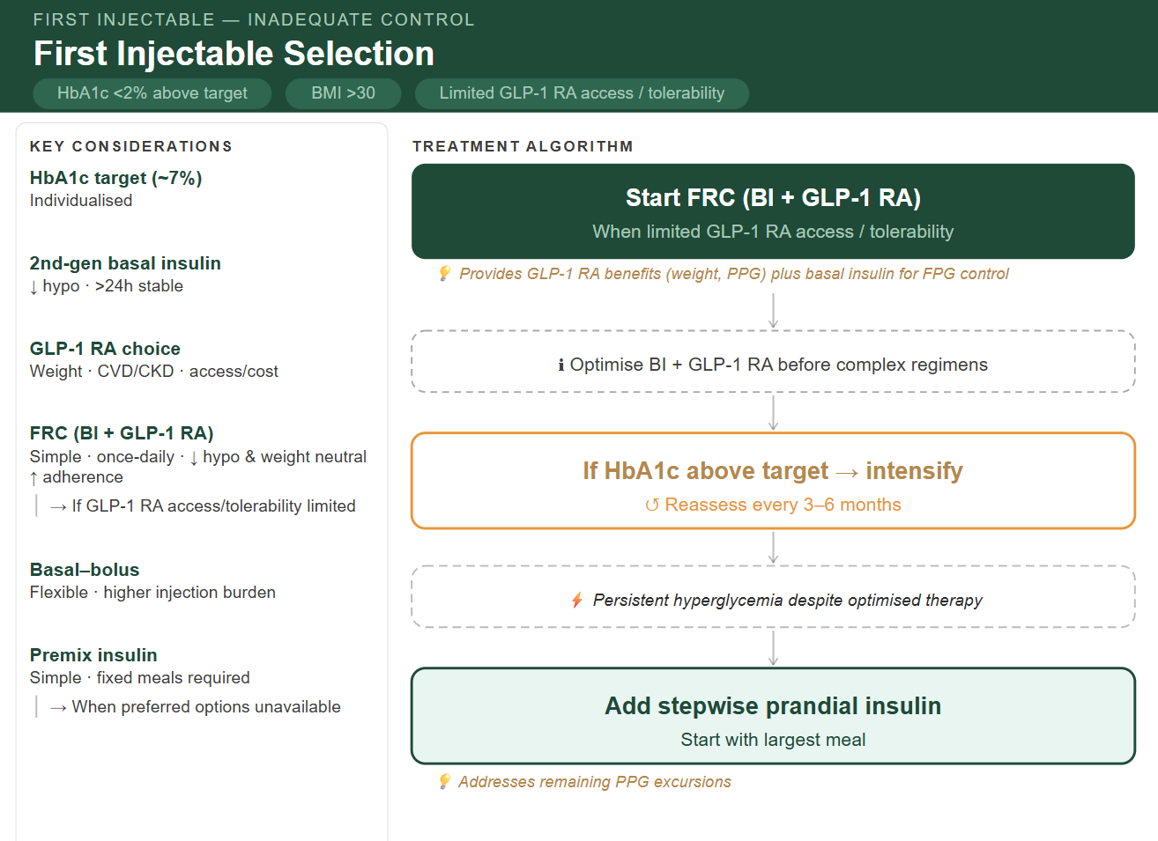
None / first injectable selection - Inadequate Control
HbA1c <2% above target | BMI >30 | Limited GLP-1 RA access / tolerability
🧠 RECOMMENDATION
🟩 Start FRC (BI + GLP-1 RA) (preferred when limited GLP-1 RA access/ tolerability)
💡 Provides GLP‑1 RA benefits (weight, PPG) plus basal insulin for FPG control
Optimize BI + GLP-1 RA before escalation to complex regimens
🟨 If HbA1c Above Target → Intensify
↺ Reassess every 3–6 months
⚡ Persistent hyperglycemia despite optimized therapy
🟩 Add stepwise prandial insulin (start with largest meal)
💡 Addresses remaining PPG excursions
🔹 Key Considerations
🧪 HbA1c target (~7%): Individualized
💉 2nd‑gen basal insulin: ↓ hypo · >24h stable
⚖️ GLP‑1 RA choice: → Weight · CVD/CKD · access/cost
🔗 FRC (BI + GLP‑1 RA): Simple · once daily · ↓ hypo · weight neutral · ↑ adherence → Consider when GLP‑1 RA access or tolerability is limited
🔄 Basal–bolus: Flexible · higher injection burden
⚖️ Premix insulin: Simple · fixed meals required → Alternative when preferred options are unavailable
Notes:
Avoid premix insulin: No GLP-1 RA component . weight gain risk counterproductive in BMI >30

Slide 13
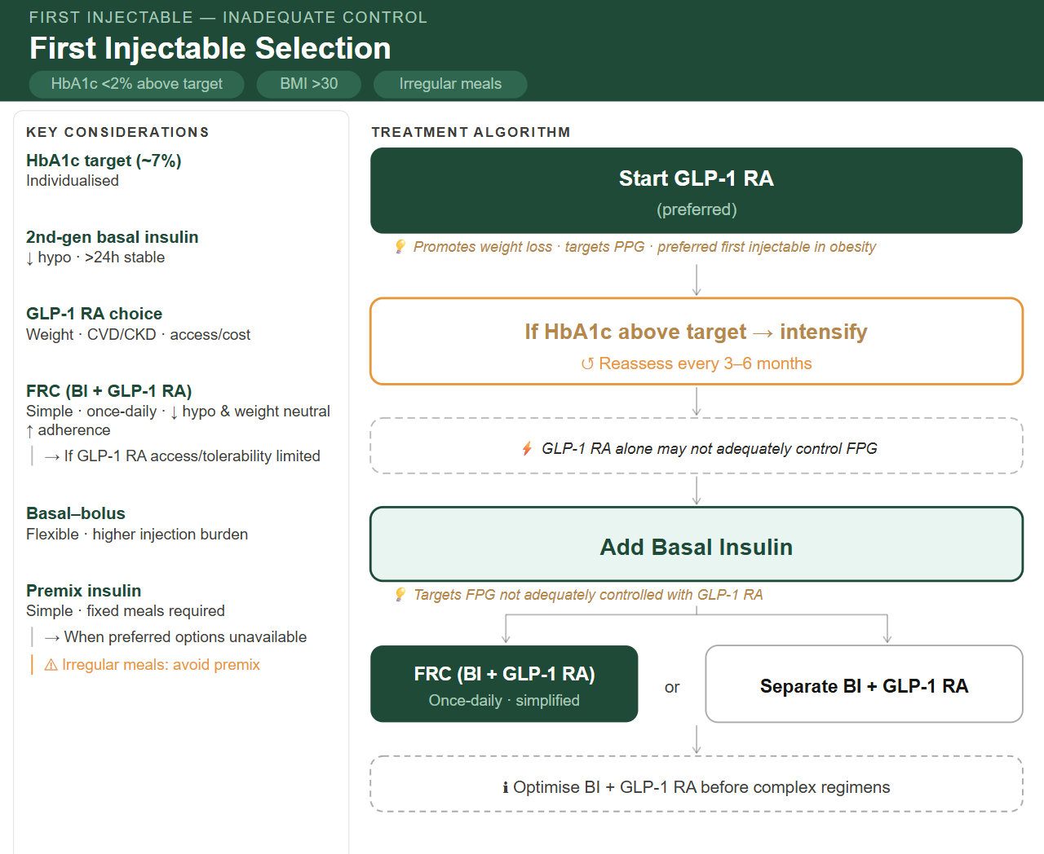
None / first injectable selection - Inadequate Control
HbA1c <2% above target | BMI >30 | irregular meals
🧠 RECOMMENDATION
🟩 Start GLP‑1 RA (preferred)
💡 Promotes weight loss · targets PPG · preferred first injectable in obesity
🟨 If HbA1c Above Target → Intensify
↺ Reassess every 3–6 months
⚡ GLP‑1 RA alone may not adequately control FPG
🟩 Add basal insulin
💡 Targets FPG not adequately controlled with GLP-1 RA
🟩 Choose Combination Strategy
🔗 FRC (BI + GLP‑1 RA)
Once daily · simplified
⚪ Separate BI + GLP‑1 RA
Optimize BI + GLP-1 RA before escalation to complex regimens
🔹 Key Considerations
🧪 HbA1c target (~7%): Individualized
💉 2nd‑gen basal insulin: ↓ hypo · >24h stable
⚖️ GLP‑1 RA choice: → Weight · CVD/CKD · access/cost
🔗 FRC (BI + GLP‑1 RA): Simple · once daily · ↓ hypo · weight neutral · ↑ adherence → Consider when GLP‑1 RA access or tolerability is limited
🔄 Basal–bolus: Flexible · higher injection burden
⚖️ Premix insulin: Simple · fixed meals required → Alternative when preferred options are unavailable
⚠ Irregular meals: avoid premix
Notes:
Avoid premix insulin: No GLP-1 RA component . weight gain risk counterproductive in BMI >30

Slide 14
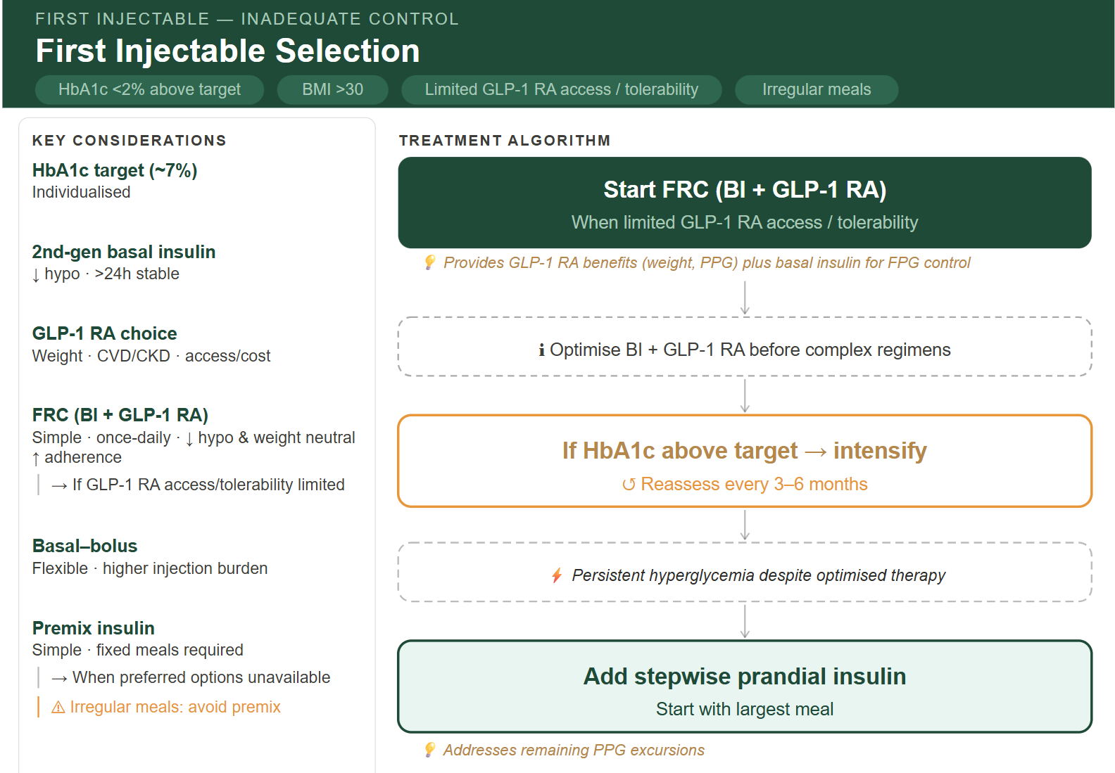
None / first injectable selection - Inadequate Control
HbA1c <2% above target | BMI >30 | Limited GLP-1 RA access / tolerability & irregular meals
🧠 RECOMMENDATION
🟩 Start FRC (BI + GLP-1 RA) (preferred when limited GLP-1 RA access/ tolerability)
💡 Provides GLP‑1 RA benefits (weight, PPG) plus basal insulin for FPG control
Optimize BI + GLP-1 RA before escalation to complex regimens
🟨 If HbA1c Above Target → Intensify
↺ Reassess every 3–6 months
⚡ Persistent hyperglycemia despite optimized therapy
🟩 Add stepwise prandial insulin (start with largest meal)
💡 Addresses remaining PPG excursions
🔹 Key Considerations
🧪 HbA1c target (~7%): Individualized
💉 2nd‑gen basal insulin: ↓ hypo · >24h stable
⚖️ GLP‑1 RA choice: → Weight · CVD/CKD · access/cost
🔗 FRC (BI + GLP‑1 RA): Simple · once daily · ↓ hypo · weight neutral · ↑ adherence → Consider when GLP‑1 RA access or tolerability is limited
🔄 Basal–bolus: Flexible · higher injection burden
⚖️ Premix insulin: Simple · fixed meals required → Alternative when preferred options are unavailable
⚠ Irregular meals: avoid premix
Notes:
Avoid premix insulin: No GLP-1 RA component . weight gain risk counterproductive in BMI >30

Slide 15
3- None / first injectable selection
HbA1c ≥ 2%
BMI ≤ 30

Slide 16
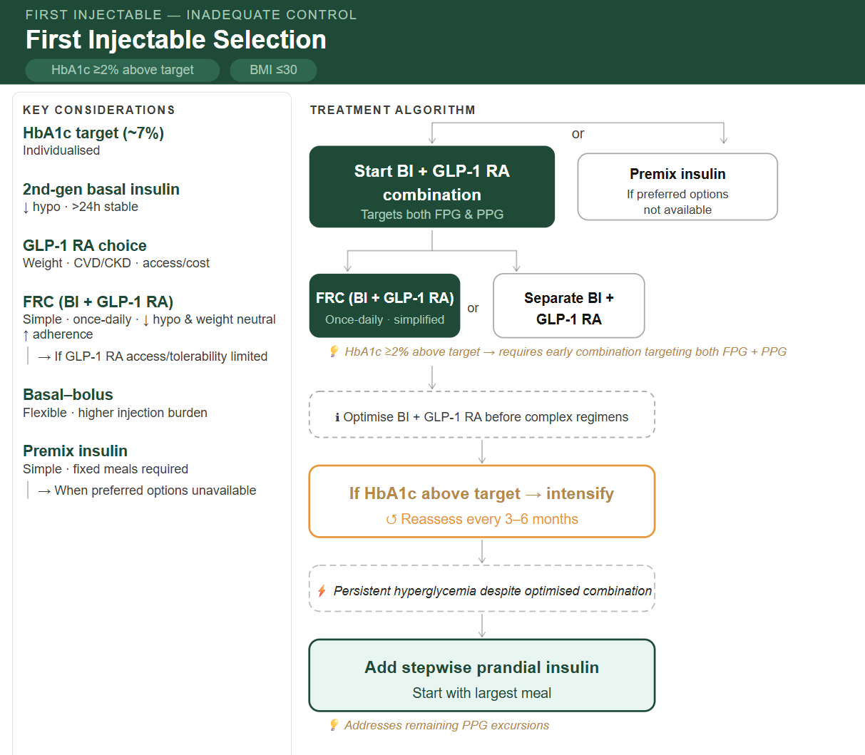
None / first injectable selection - Inadequate Control
HbA1c ≥2% above target | BMI ≤30
🧠 RECOMMENDATION
🟩 Start BI + GLP-1 RA combination
FRC (BI + GLP-1 RA) – Once daily- simplified
Or free combination - Separate BI & GLP-1 RA
💡 HbA1c ≥2% above target → early combination targeting both FPG/PPG
Optimize BI + GLP-1 RA before escalation to complex regimens
OR Premix insulin: if preferred options are not available
🟨 If HbA1c Above Target → Intensify
↺ Reassess every 3–6 months
⚡ Persistent hyperglycemia despite optimized combination
🟩 Add stepwise prandial insulin (start with largest meal)
💡 Addresses remaining PPG excursions
🔹 Key Considerations
🧪 HbA1c target (~7%): Individualized
💉 2nd‑gen basal insulin: ↓ hypo · >24h stable
⚖️ GLP‑1 RA choice: → Weight · CVD/CKD · access/cost
🔗 FRC (BI + GLP‑1 RA): Simple · once daily · ↓ hypo · weight neutral · ↑ adherence → Consider when GLP‑1 RA access or tolerability is limited
🔄 Basal–bolus: Flexible · higher injection burden
⚖️ Premix insulin: Simple · fixed meals required → Alternative when preferred options are unavailable
Notes:
Clinical alignment, clarity, actionable

Slide 17
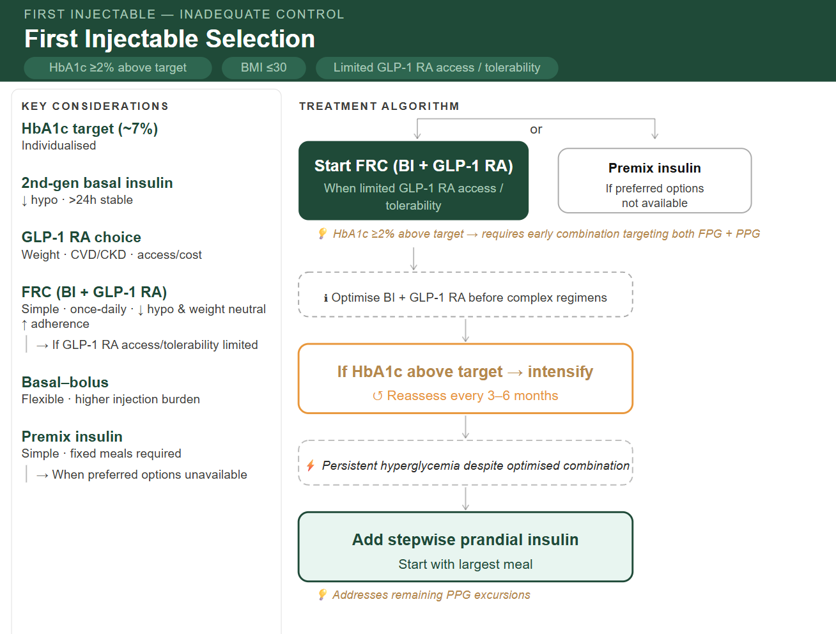
None / first injectable selection - Inadequate Control
HbA1c ≥2% above target | BMI ≤30 | Limited GLP-1 RA access / tolerability
🧠 RECOMMENDATION
🟩 Start FRC (BI + GLP-1 RA) – (preferred when limited GLP-1 RA access/ tolerability)
💡 HbA1c ≥2% above target → early combination targeting both FPG/PPG
Optimize BI + GLP-1 RA before escalation to complex regimens
OR Premix insulin: if preferred options are not available
🟨 If HbA1c Above Target → Intensify
↺ Reassess every 3–6 months
⚡ Persistent hyperglycemia despite optimized combination
🟩 Add stepwise prandial insulin (start with largest meal)
💡 Addresses remaining PPG excursions
🔹 Key Considerations
🧪 HbA1c target (~7%): Individualized
💉 2nd‑gen basal insulin:↓ hypo · >24h stable
⚖️ GLP‑1 RA choice: → Weight · CVD/CKD · access/cost
🔗 FRC (BI + GLP‑1 RA): Simple · once daily · ↓ hypo · weight neutral · ↑ adherence → Consider when GLP‑1 RA access or tolerability is limited
🔄 Basal–bolus: Flexible · higher injection burden
⚖️ Premix insulin: Simple · fixed meals required → Alternative when preferred options are unavailable
Notes:
Clinical alignment, clarity, actionable

Slide 18
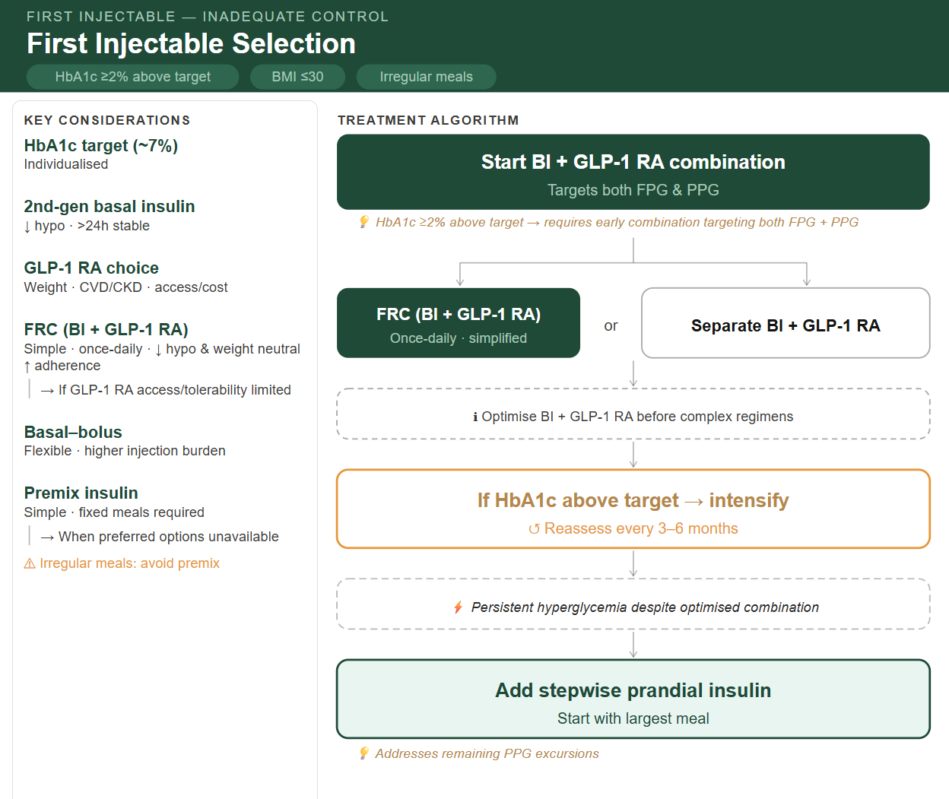
None / first injectable selection - Inadequate Control
HbA1c ≥2% above target | BMI ≤30 | irregular meal
🧠 RECOMMENDATION
🟩 Start BI + GLP-1 RA combination
FRC (BI + GLP-1 RA) – Once daily- simplified
Or free combination - Separate BI & GLP-1 RA
💡 HbA1c ≥2% above target → early combination targeting both FPG/PPG
Optimize BI + GLP-1 RA before escalation to complex regimens
🟨 If HbA1c Above Target → Intensify
↺ Reassess every 3–6 months
⚡ Persistent hyperglycemia despite optimized combination
🟩 Add stepwise prandial insulin (start with largest meal)
💡 Addresses remaining PPG excursions
🔹 Key Considerations
🧪 HbA1c target (~7%): Individualized
💉 2nd‑gen basal insulin:↓ hypo · >24h stable
⚖️ GLP‑1 RA choice: → Weight · CVD/CKD · access/cost
🔗 FRC (BI + GLP‑1 RA): Simple · once daily · ↓ hypo · weight neutral · ↑ adherence → Consider when GLP‑1 RA access or tolerability is limited
🔄 Basal–bolus: Flexible · higher injection burden
⚖️ Premix insulin: Simple · fixed meals required → Alternative when preferred options are unavailable
⚠ Irregular meals: avoid premix
Notes:
Clinical alignment, clarity, actionable

Slide 19
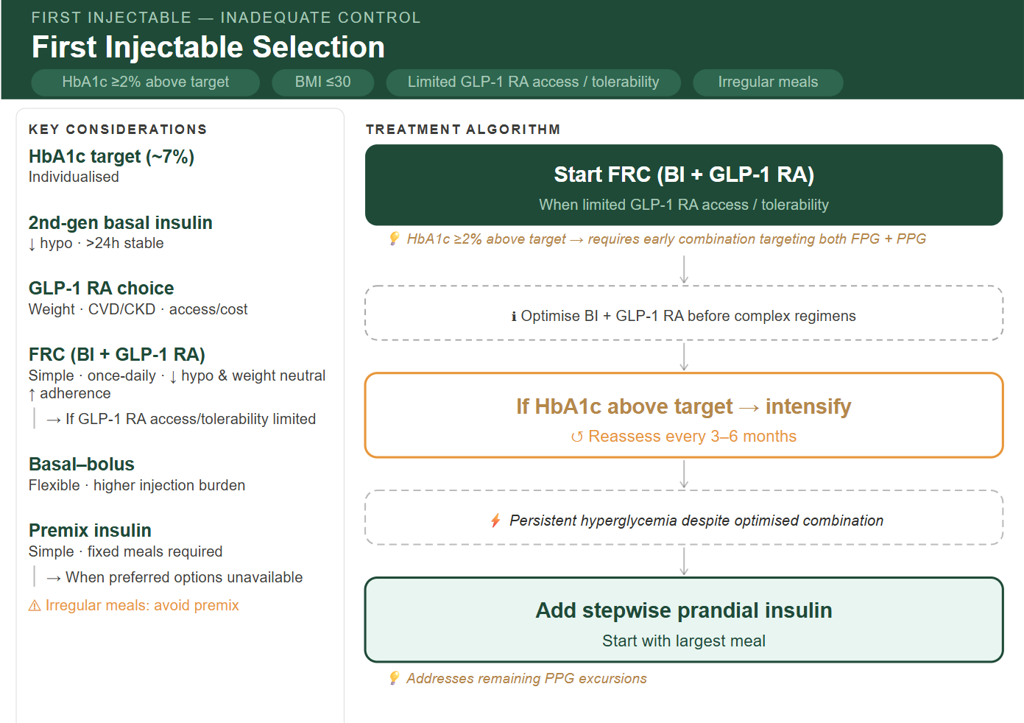
None / first injectable selection - Inadequate Control
HbA1c ≥2% above target | BMI ≤30 | Limited GLP-1 RA access / tolerability & irregular meal
🧠 RECOMMENDATION
🟩 Start FRC (BI + GLP-1 RA) – (preferred when limited GLP-1 RA access/ tolerability)
💡 HbA1c ≥2% above target → early combination targeting both FPG/PPG
Optimize BI + GLP-1 RA before escalation to complex regimens
🟨 If HbA1c Above Target → Intensify
↺ Reassess every 3–6 months
⚡ Persistent hyperglycemia despite optimized combination
🟩 Add stepwise prandial insulin (start with largest meal)
💡 Addresses remaining PPG excursions
🔹 Key Considerations
🧪 HbA1c target (~7%): Individualized
💉 2nd‑gen basal insulin:↓ hypo · >24h stable
⚖️ GLP‑1 RA choice: → Weight · CVD/CKD · access/cost
🔗 FRC (BI + GLP‑1 RA): Simple · once daily · ↓ hypo · weight neutral · ↑ adherence → Consider when GLP‑1 RA access or tolerability is limited
🔄 Basal–bolus: Flexible · higher injection burden
⚖️ Premix insulin: Simple · fixed meals required → Alternative when preferred options are unavailable
⚠ Irregular meals: avoid premix
Notes:
Clinical alignment, clarity, actionable

Slide 20
4- None / first injectable selection
HbA1c ≥ 2%
BMI > 30

Slide 21
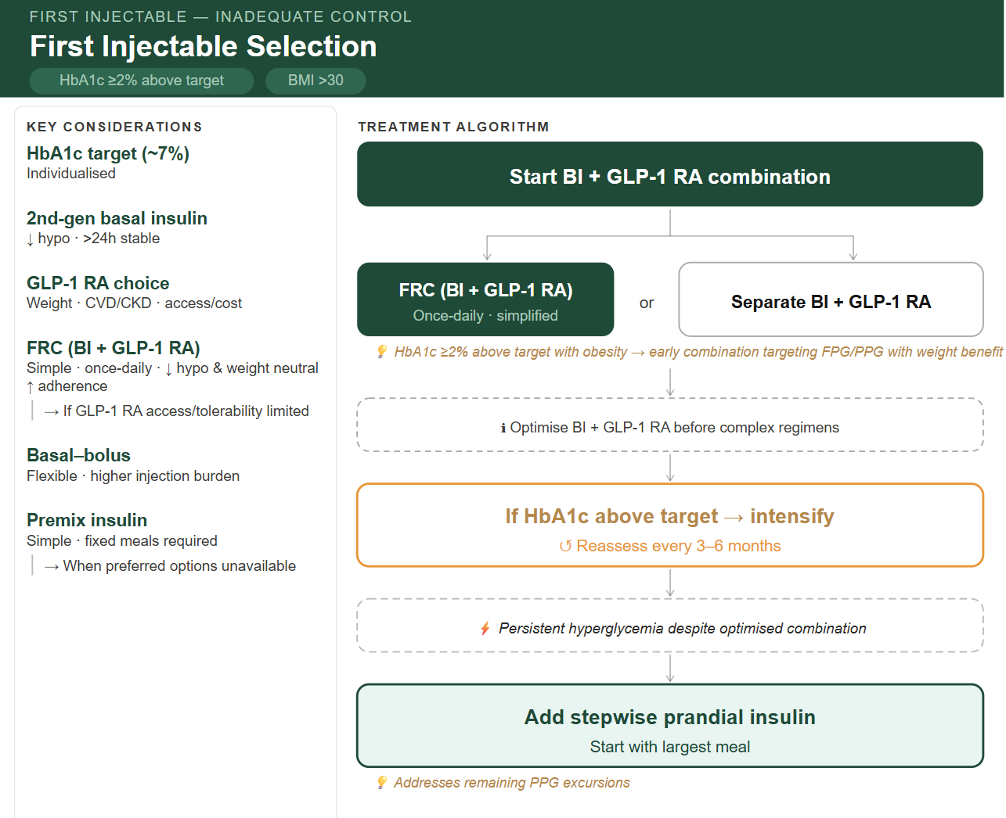
None / first injectable selection - Inadequate Control
HbA1c ≥2% above target | BMI >30
🧠 RECOMMENDATION
🟩 Start BI + GLP-1 RA combination
FRC (BI + GLP-1 RA) – Once daily- simplified
Or free combination - Separate BI & GLP-1 RA
💡 HbA1c ≥2% above target with obesity → early combination targeting FPG/PPG with weight benefit
Optimize BI + GLP-1 RA before escalation to complex regimens
🟨 If HbA1c Above Target → Intensify
↺ Reassess every 3–6 months
⚡ Persistent hyperglycemia despite optimized combination
🟩 Add stepwise prandial insulin (start with largest meal)
💡 Addresses remaining PPG excursions
🔹 Key Considerations
🧪 HbA1c target (~7%): Individualized
💉 2nd‑gen basal insulin:↓ hypo · >24h stable
⚖️ GLP‑1 RA choice: → Weight · CVD/CKD · access/cost
🔗 FRC (BI + GLP‑1 RA): Simple · once daily · ↓ hypo · weight neutral · ↑ adherence → Consider when GLP‑1 RA access or tolerability is limited
🔄 Basal–bolus: Flexible · higher injection burden
⚖️ Premix insulin: Simple · fixed meals required → Alternative when preferred options are unavailable
Notes:
Clinical alignment, clarity, actionable

Slide 22
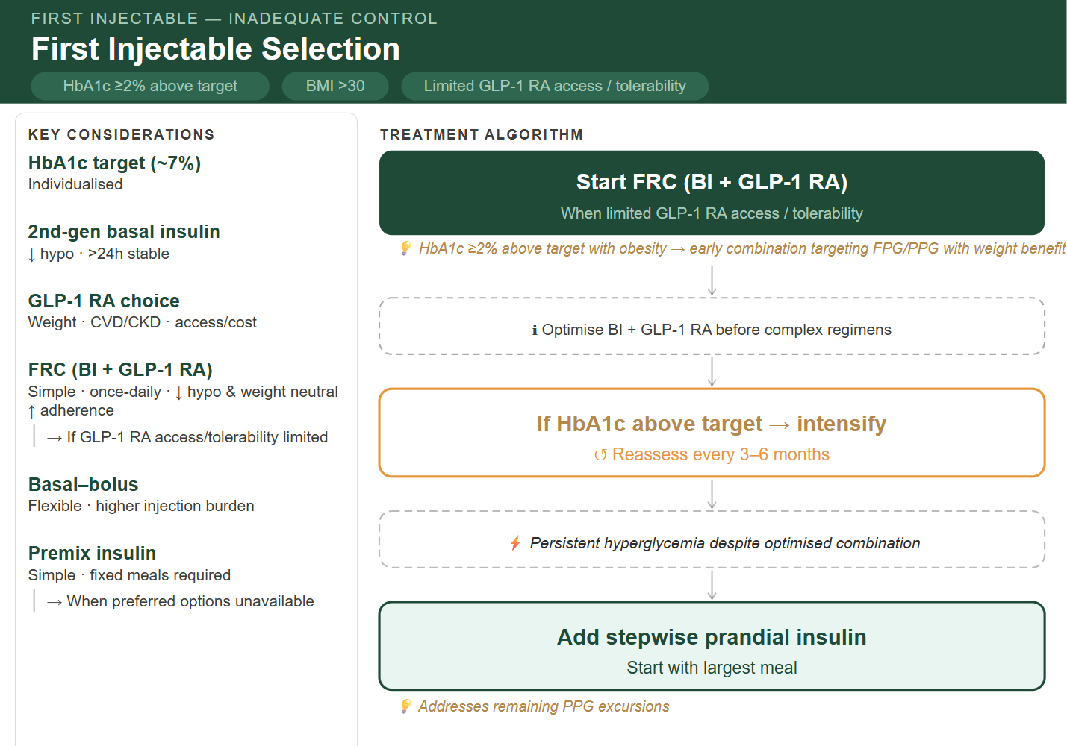
None / first injectable selection - Inadequate Control
HbA1c ≥2% above target | BMI >30 | Limited GLP-1 RA access / tolerability
🧠 RECOMMENDATION
🟩 Start FRC (BI + GLP-1 RA) – (preferred when limited GLP-1 RA access/ tolerability)
💡 HbA1c ≥2% above target with obesity → early combination targeting FPG/PPG with weight benefit
Optimize BI + GLP-1 RA before escalation to complex regimens
🟨 If HbA1c Above Target → Intensify
↺ Reassess every 3–6 months
⚡ Persistent hyperglycemia despite optimized combination
🟩 Add stepwise prandial insulin (start with largest meal)
💡 Addresses remaining PPG excursions
🔹 Key Considerations
🧪 HbA1c target (~7%): Individualized
💉 2nd‑gen basal insulin:↓ hypo · >24h stable
⚖️ GLP‑1 RA choice: → Weight · CVD/CKD · access/cost
🔗 FRC (BI + GLP‑1 RA): Simple · once daily · ↓ hypo · weight neutral · ↑ adherence → Consider when GLP‑1 RA access or tolerability is limited
🔄 Basal–bolus: Flexible · higher injection burden
⚖️ Premix insulin: Simple · fixed meals required → Alternative when preferred options are unavailable
Notes:
Clinical alignment, clarity, actionable

Slide 23

None / first injectable selection - Inadequate Control
HbA1c ≥2% above target | BMI >30 | irregular meals
🧠 RECOMMENDATION
🟩 Start BI + GLP-1 RA combination
FRC (BI + GLP-1 RA) – Once daily- simplified
Or free combination - Separate BI & GLP-1 RA
💡 HbA1c ≥2% above target with obesity → early combination targeting FPG/PPG with weight benefit
Optimize BI + GLP-1 RA before escalation to complex regimens
🟨 If HbA1c Above Target → Intensify
↺ Reassess every 3–6 months
⚡ Persistent hyperglycemia despite optimized combination
🟩 Add stepwise prandial insulin (start with largest meal)
💡 Addresses remaining PPG excursions
🔹 Key Considerations
🧪 HbA1c target (~7%): Individualized
💉 2nd‑gen basal insulin:↓ hypo · >24h stable
⚖️ GLP‑1 RA choice: → Weight · CVD/CKD · access/cost
🔗 FRC (BI + GLP‑1 RA): Simple · once daily · ↓ hypo · weight neutral · ↑ adherence → Consider when GLP‑1 RA access or tolerability is limited
🔄 Basal–bolus: Flexible · higher injection burden
⚖️ Premix insulin: Simple · fixed meals required → Alternative when preferred options are unavailable
⚠ Irregular meals: avoid premix
Notes:
Clinical alignment, clarity, actionable

Slide 24
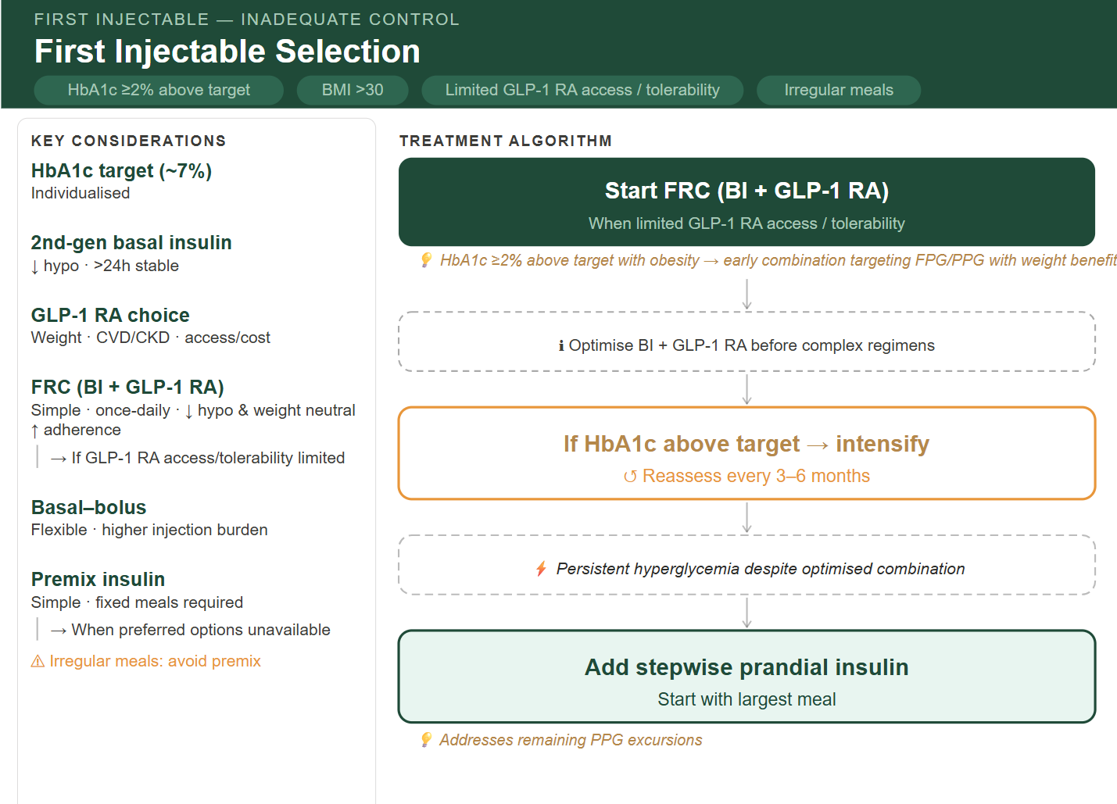
None / first injectable selection - Inadequate Control
HbA1c ≥2% above target | BMI >30 | Limited GLP-1 RA access / tolerability & irregular meals
🧠 RECOMMENDATION
🟩 Start FRC (BI + GLP-1 RA) – (preferred when limited GLP-1 RA access/ tolerability)
💡 HbA1c ≥2% above target with obesity → early combination targeting FPG/PPG with weight benefit
Optimize BI + GLP-1 RA before escalation to complex regimens
🟨 If HbA1c Above Target → Intensify
↺ Reassess every 3–6 months
⚡ Persistent hyperglycemia despite optimized combination
🟩 Add stepwise prandial insulin (start with largest meal)
💡 Addresses remaining PPG excursions
🔹 Key Considerations
🧪 HbA1c target (~7%): Individualized
💉 2nd‑gen basal insulin:↓ hypo · >24h stable
⚖️ GLP‑1 RA choice: → Weight · CVD/CKD · access/cost
🔗 FRC (BI + GLP‑1 RA): Simple · once daily · ↓ hypo · weight neutral · ↑ adherence → Consider when GLP‑1 RA access or tolerability is limited
🔄 Basal–bolus: Flexible · higher injection burden
⚖️ Premix insulin: Simple · fixed meals required → Alternative when preferred options are unavailable
⚠ Irregular meals: avoid premix
Notes:
Clinical alignment, clarity, actionable

Slide 25
T2D Injectable Therapy CDS
On Basal Insulin- Inadequate control

Slide 26
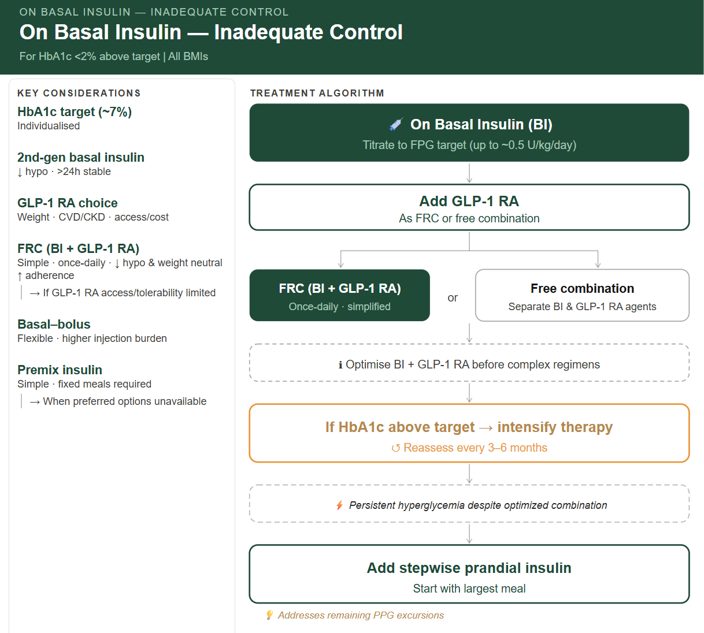
On basal insulin - Inadequate control
For HbA1c <2% above target | All BMIs
🧠 RECOMMENDATION
🟩 Titrate Basal Insulin to FPG Target
(up to ~0.5 U/kg/day)
🟩 Add GLP‑1 RA
💡 Targets PPG · supports weight control · low hypo risk
🟩 Choose Combination Strategy
🔗 FRC (BI + GLP‑1 RA)
Once daily · simplified
⚪ Separate BI + GLP‑1 RA
Optimize BI + GLP-1 RA before escalation to complex regimens
🟨 If HbA1c Above Target → Intensify
↺ Reassess every 3–6 months
⚡ Persistent hyperglycemia despite optimized combination
🟩 Add stepwise prandial insulin (start with largest meal)
💡 Addresses remaining PPG excursions
🔹 Key Considerations
🧪 HbA1c target (~7%): Individualized
💉 2nd‑gen basal insulin:↓ hypo · >24h stable
⚖️ GLP‑1 RA choice: → Weight · CVD/CKD · access/cost
🔗 FRC (BI + GLP‑1 RA): Simple · once daily · ↓ hypo · weight neutral · ↑ adherence → Consider when GLP‑1 RA access or tolerability is limited
🔄 Basal–bolus: Flexible · higher injection burden
⚖️ Premix insulin: Simple · fixed meals required → Alternative when preferred options are unavailable
Notes:
Clinical alignment, clarity, actionable

Slide 27
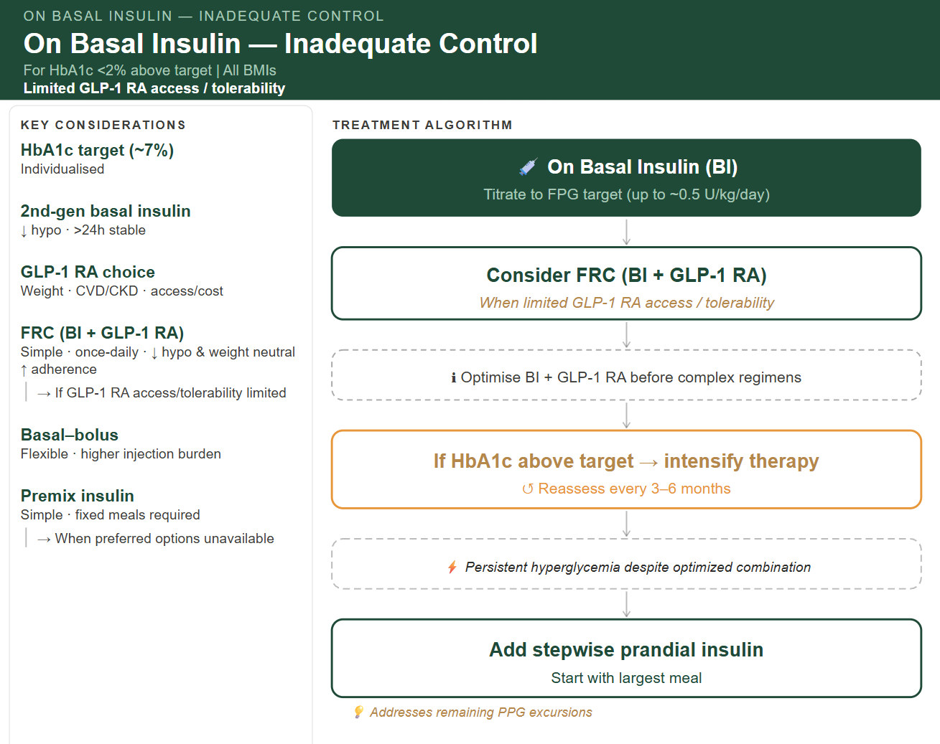
On basal insulin - Inadequate control
For HbA1c <2% above target | All BMIs
Limited GLP-1 RA access / tolerability
🧠 RECOMMENDATION
🟩 Titrate Basal Insulin to FPG Target
(up to ~0.5 U/kg/day)
🟩 Consider FRC (BI + GLP-1 RA) – (preferred when limited GLP-1 RA access/ tolerability)
💡 Targets FPG & PPG · weight neutral · low hypo risk
Optimize BI + GLP-1 RA before escalation to complex regimens
🟨 If HbA1c Above Target → Intensify
↺ Reassess every 3–6 months
⚡ Persistent hyperglycemia despite optimized combination
🟩 Add stepwise prandial insulin (start with largest meal)
💡 Addresses remaining PPG excursions
🔹 Key Considerations
🧪 HbA1c target (~7%): Individualized
💉 2nd‑gen basal insulin:↓ hypo · >24h stable
⚖️ GLP‑1 RA choice: → Weight · CVD/CKD · access/cost
🔗 FRC (BI + GLP‑1 RA): Simple · once daily · ↓ hypo · weight neutral · ↑ adherence → Consider when GLP‑1 RA access or tolerability is limited
🔄 Basal–bolus: Flexible · higher injection burden
⚖️ Premix insulin: Simple · fixed meals required → Alternative when preferred options are unavailable
Notes:
Clinical alignment, clarity, actionable

Slide 28
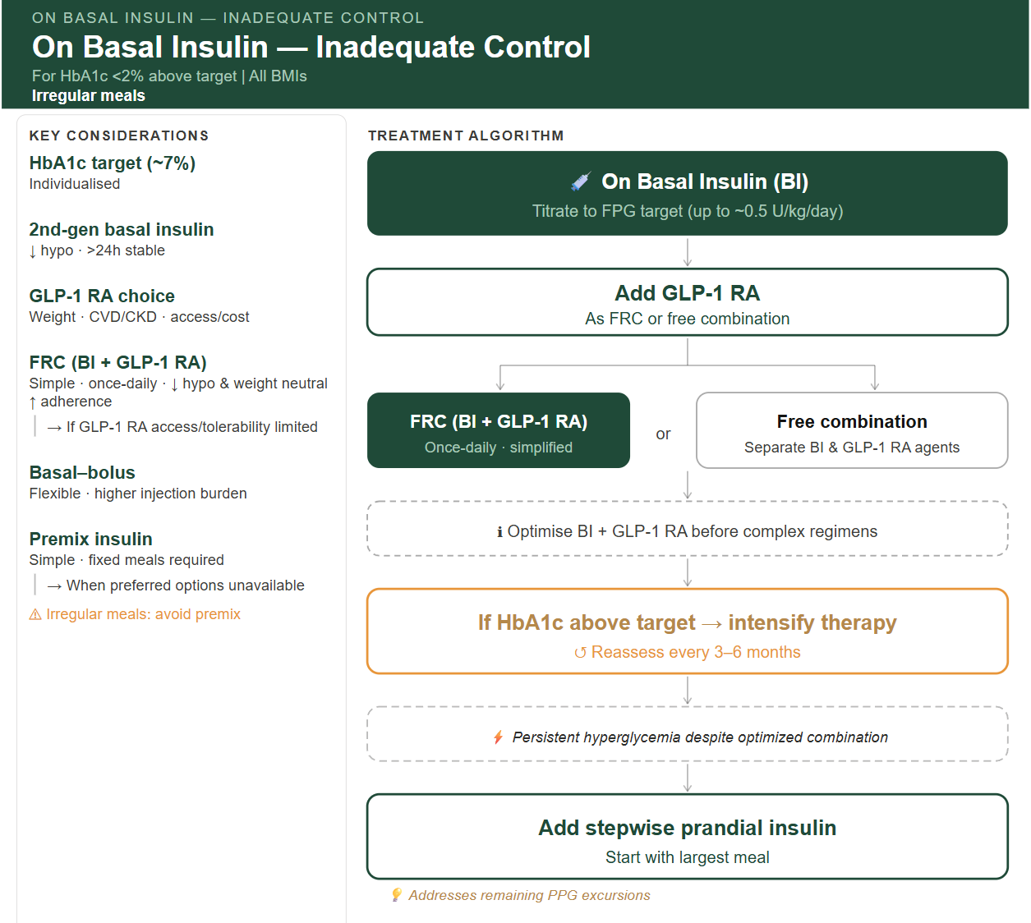
On basal insulin - Inadequate control
For HbA1c <2% above target | All BMIs
irregular meal
🧠 RECOMMENDATION
🟩 Titrate Basal Insulin to FPG Target
(up to ~0.5 U/kg/day)
🟩 Add GLP‑1 RA
💡 Targets PPG · supports weight control · low hypo risk
🟩 Choose Combination Strategy
🔗 FRC (BI + GLP‑1 RA)
Once daily · simplified
⚪ Separate BI + GLP‑1 RA
Optimize BI + GLP-1 RA before escalation to complex regimens
🟨 If HbA1c Above Target → Intensify
↺ Reassess every 3–6 months
⚡ Persistent hyperglycemia despite optimized combination
🟩 Add stepwise prandial insulin (start with largest meal)
💡 Addresses remaining PPG excursions
🔹 Key Considerations
🧪 HbA1c target (~7%): Individualized
💉 2nd‑gen basal insulin:↓ hypo · >24h stable
⚖️ GLP‑1 RA choice: → Weight · CVD/CKD · access/cost
🔗 FRC (BI + GLP‑1 RA): Simple · once daily · ↓ hypo · weight neutral · ↑ adherence → Consider when GLP‑1 RA access or tolerability is limited
🔄 Basal–bolus: Flexible · higher injection burden
⚖️ Premix insulin: Simple · fixed meals required → Alternative when preferred options are unavailable
⚠ Irregular meals: avoid premix
Notes:
Clinical alignment, clarity, actionable

Slide 29
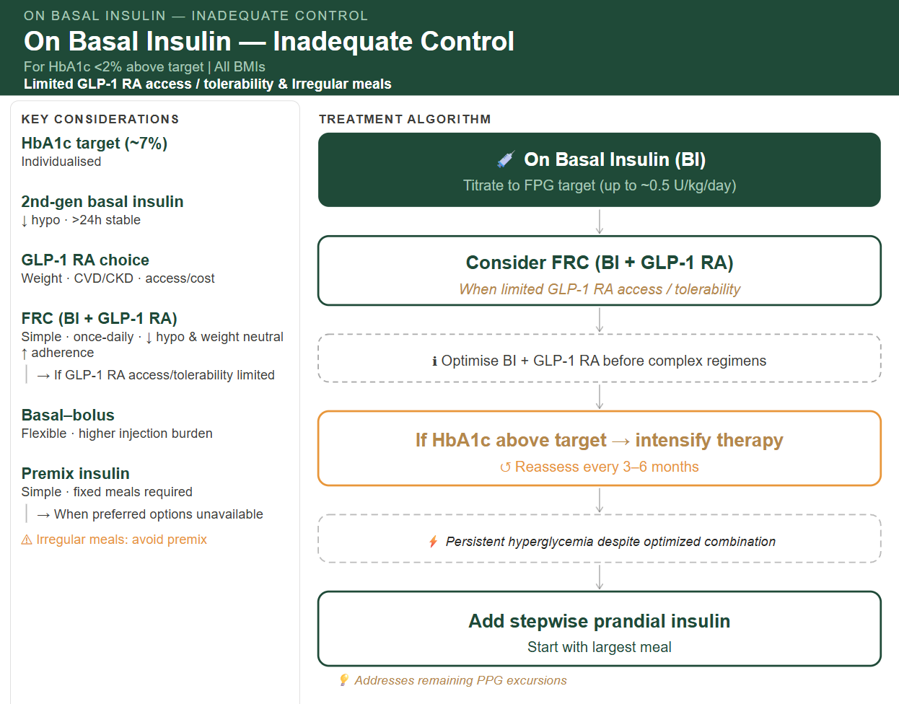
On basal insulin - Inadequate control
For HbA1c <2% above target | All BMIs
Limited GLP-1 RA access / tolerability & irregular meal
🧠 RECOMMENDATION
🟩 Titrate Basal Insulin to FPG Target
(up to ~0.5 U/kg/day)
🟩 Consider FRC (BI + GLP-1 RA) – (preferred when limited GLP-1 RA access/ tolerability)
💡 Targets FPG & PPG · weight neutral · low hypo risk
Optimize BI + GLP-1 RA before escalation to complex regimens
🟨 If HbA1c Above Target → Intensify
↺ Reassess every 3–6 months
⚡ Persistent hyperglycemia despite optimized combination
🟩 Add stepwise prandial insulin (start with largest meal)
💡 Addresses remaining PPG excursions
🔹 Key Considerations
🧪 HbA1c target (~7%): Individualized
💉 2nd‑gen basal insulin:↓ hypo · >24h stable
⚖️ GLP‑1 RA choice: → Weight · CVD/CKD · access/cost
🔗 FRC (BI + GLP‑1 RA): Simple · once daily · ↓ hypo · weight neutral · ↑ adherence → Consider when GLP‑1 RA access or tolerability is limited
🔄 Basal–bolus: Flexible · higher injection burden
⚖️ Premix insulin: Simple · fixed meals required → Alternative when preferred options are unavailable
⚠ Irregular meals: avoid premix
Notes:
preferably FRC; particularly useful when access/tolerability is limited

Slide 30
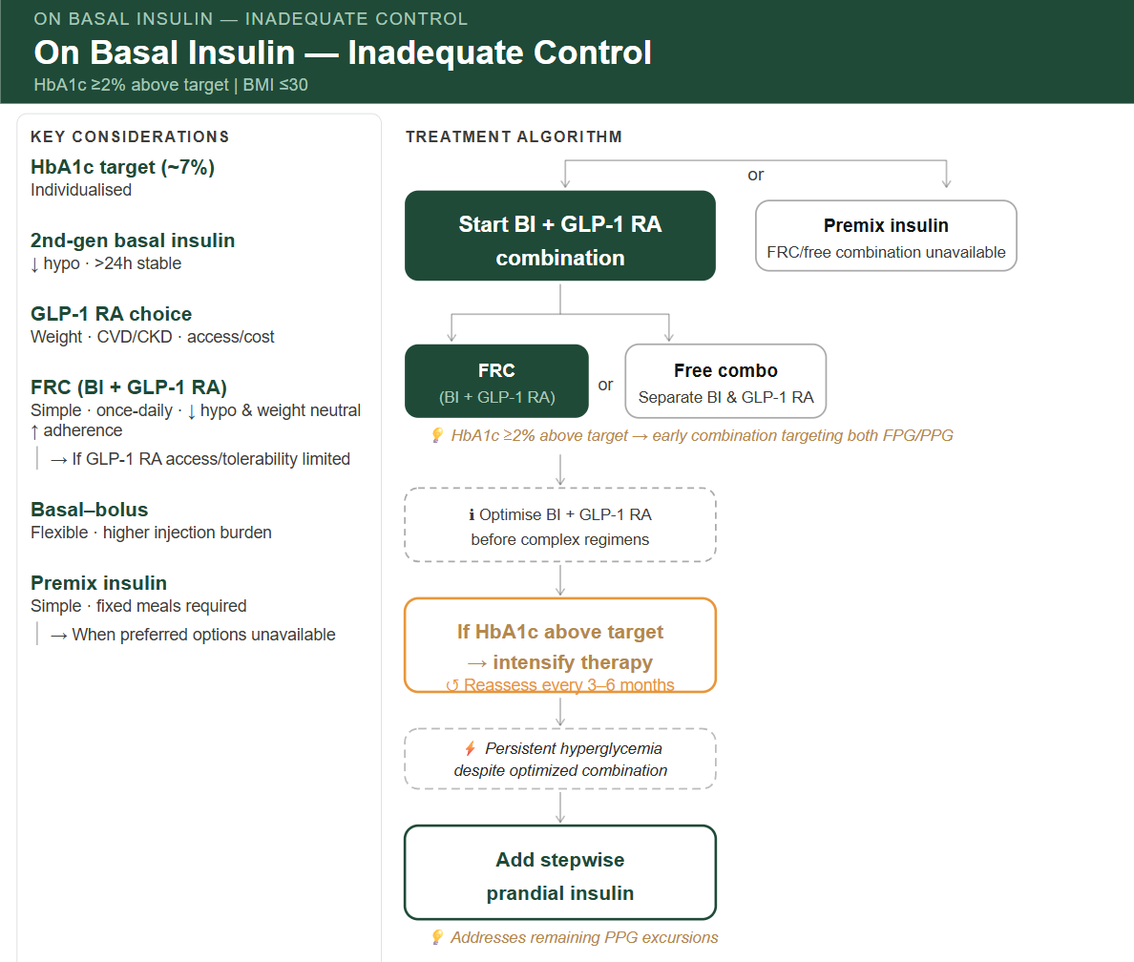
On basal insulin - Inadequate control
HbA1c ≥2% above target | BMI ≤30
🧠 RECOMMENDATION
🟩 Start BI + GLP-1 RA combination
FRC (BI + GLP-1 RA) – Once daily- simplified
Or free combination - Separate BI & GLP-1 RA
💡 HbA1c ≥2% above target → early combination targeting both FPG/PPG
Optimize BI + GLP-1 RA before escalation to complex regimens
🟩Alternative: premix insulin (when FRC/free combination unavailable)
🟨 If HbA1c Above Target → Intensify
↺ Reassess every 3–6 months
⚡ Persistent hyperglycemia despite optimized combination
🟩 Add stepwise prandial insulin (start with largest meal)
💡 Addresses remaining PPG excursions
🔹 Key Considerations
🧪 HbA1c target (~7%): Individualized
💉 2nd‑gen basal insulin:↓ hypo · >24h stable
⚖️ GLP‑1 RA choice: → Weight · CVD/CKD · access/cost
🔗 FRC (BI + GLP‑1 RA): Simple · once daily · ↓ hypo · weight neutral · ↑ adherence → Consider when GLP‑1 RA access or tolerability is limited
🔄 Basal–bolus: Flexible · higher injection burden
⚖️ Premix insulin: Simple · fixed meals required → Alternative when preferred options are unavailable
Notes:
Clinical alignment, clarity, actionable

Slide 31
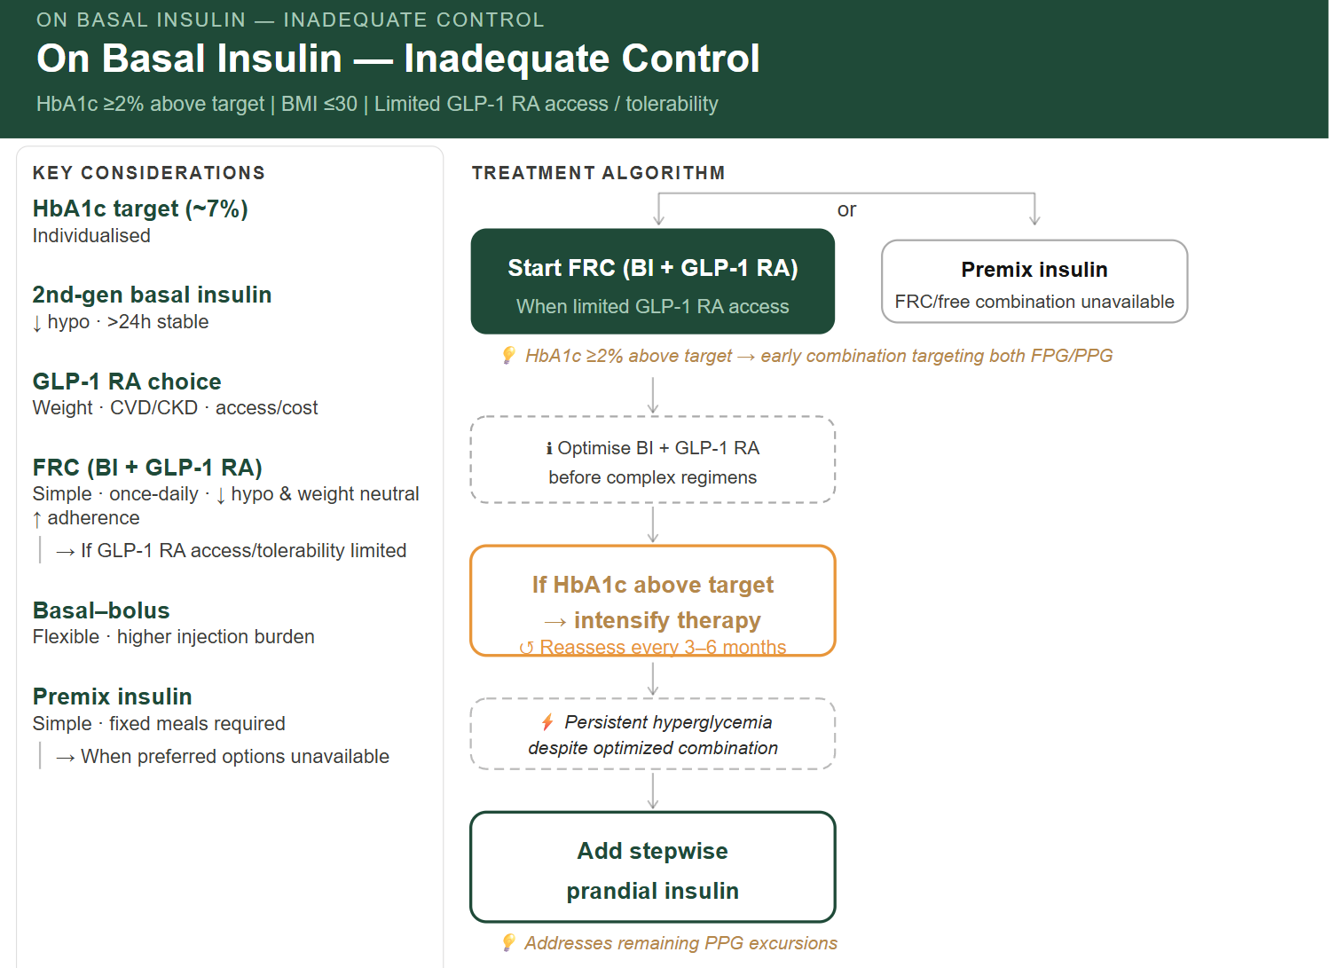
On basal insulin - Inadequate control
HbA1c ≥2% above target | BMI ≤30
Limited GLP-1 RA access / tolerability
🧠 RECOMMENDATION
🟩 Start FRC (BI + GLP-1 RA) – (preferred when limited GLP-1 RA access/ tolerability)
💡 HbA1c ≥2% above target → early combination targeting both FPG/PPG
Optimize BI + GLP-1 RA before escalation to complex regimens
🟩Alternative: premix insulin (when FRC/free combination unavailable)
🟨 If HbA1c Above Target → Intensify
↺ Reassess every 3–6 months
⚡ Persistent hyperglycemia despite optimized combination
🟩 Add stepwise prandial insulin (start with largest meal)
💡 Addresses remaining PPG excursions
🔹 Key Considerations
🧪 HbA1c target (~7%): Individualized
💉 2nd‑gen basal insulin:↓ hypo · >24h stable
⚖️ GLP‑1 RA choice: → Weight · CVD/CKD · access/cost
🔗 FRC (BI + GLP‑1 RA): Simple · once daily · ↓ hypo · weight neutral · ↑ adherence → Consider when GLP‑1 RA access or tolerability is limited
🔄 Basal–bolus: Flexible · higher injection burden
⚖️ Premix insulin: Simple · fixed meals required → Alternative when preferred options are unavailable
Notes:
Clinical alignment, clarity, actionable

Slide 32
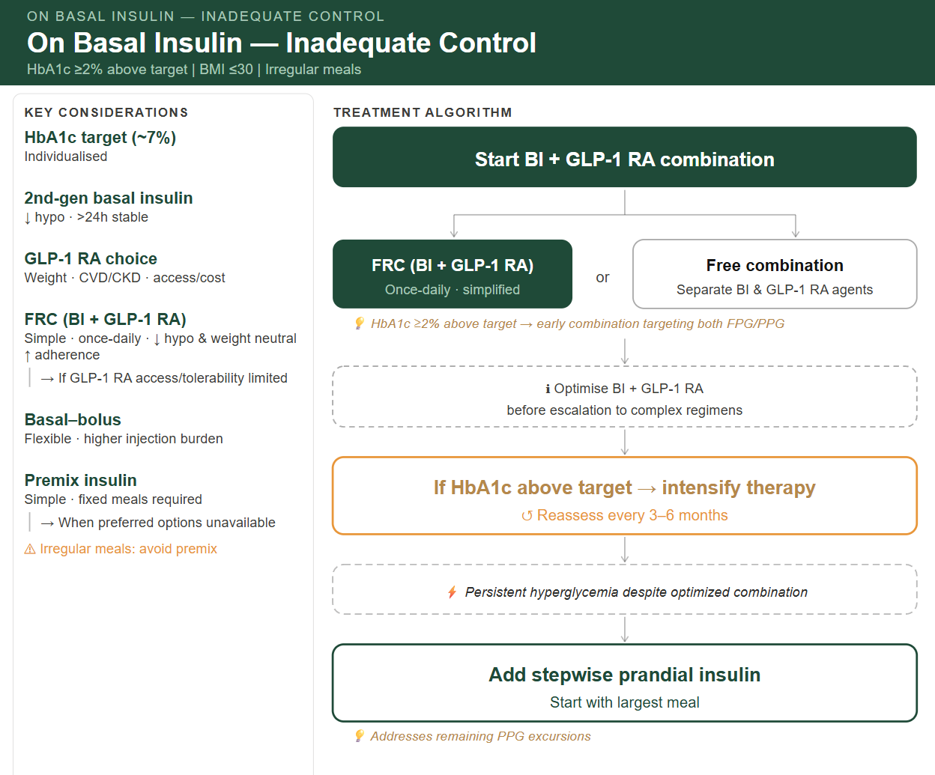
On basal insulin - Inadequate control
HbA1c ≥2% above target | BMI ≤30 | irregular meals
🧠 RECOMMENDATION
🟩 Start BI + GLP-1 RA combination
FRC (BI + GLP-1 RA) – Once daily- simplified
Or free combination - Separate BI & GLP-1 RA
💡 HbA1c ≥2% above target → early combination targeting both FPG/PPG
Optimize BI + GLP-1 RA before escalation to complex regimens
🟨 If HbA1c Above Target → Intensify
↺ Reassess every 3–6 months
⚡ Persistent hyperglycemia despite optimized combination
🟩 Add stepwise prandial insulin (start with largest meal)
💡 Addresses remaining PPG excursions
🔹 Key Considerations
🧪 HbA1c target (~7%): Individualized
💉 2nd‑gen basal insulin:↓ hypo · >24h stable
⚖️ GLP‑1 RA choice: → Weight · CVD/CKD · access/cost
🔗 FRC (BI + GLP‑1 RA): Simple · once daily · ↓ hypo · weight neutral · ↑ adherence → Consider when GLP‑1 RA access or tolerability is limited
🔄 Basal–bolus: Flexible · higher injection burden
⚖️ Premix insulin: Simple · fixed meals required → Alternative when preferred options are unavailable
⚠ Irregular meals: avoid premix
Notes:
Clinical alignment, clarity, actionable

Slide 33
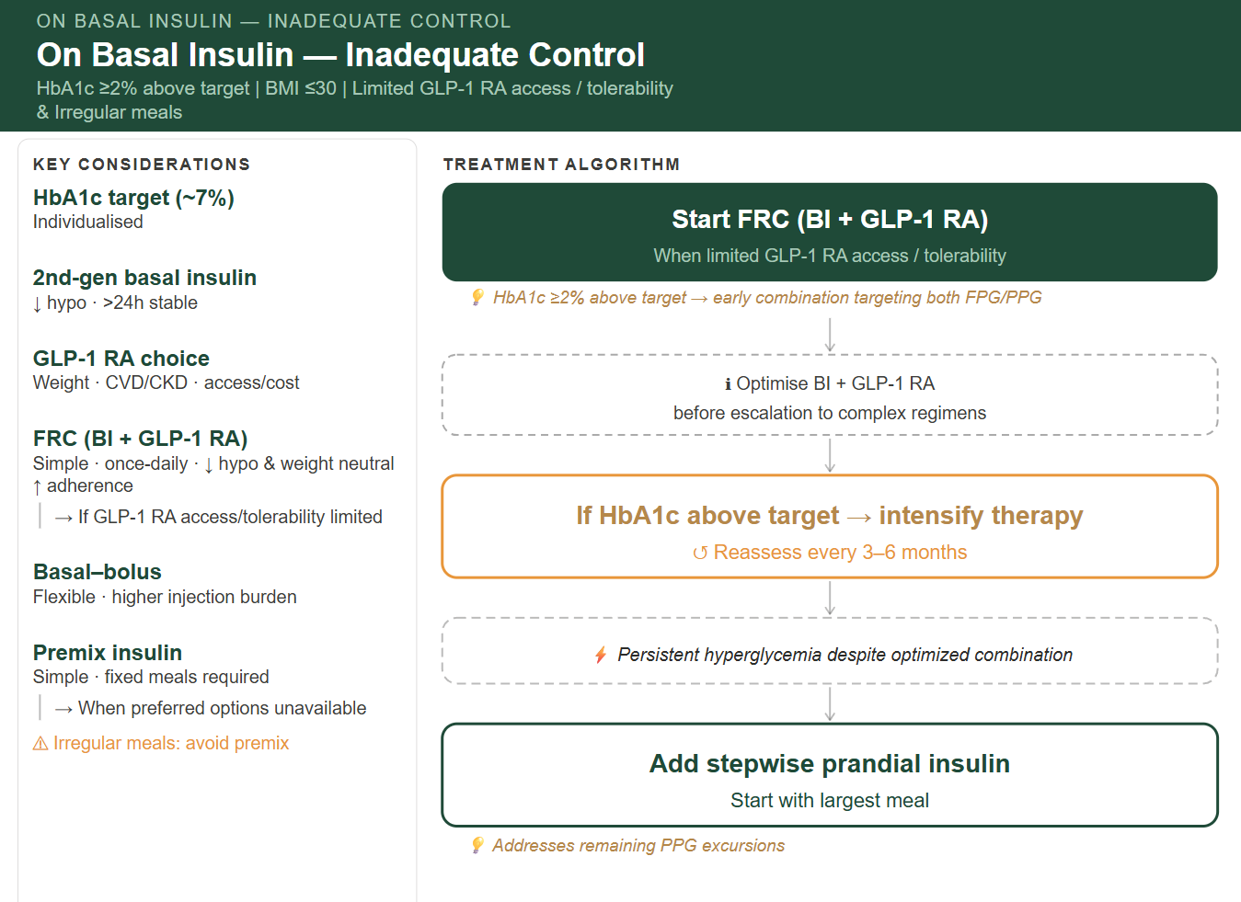
On basal insulin - Inadequate control
HbA1c ≥2% above target | BMI ≤30 |
Limited GLP-1 RA access / tolerability & irregular meals
🧠 RECOMMENDATION
🟩 Start FRC (BI + GLP-1 RA) – (preferred when limited GLP-1 RA access/ tolerability)
💡 HbA1c ≥2% above target → early combination targeting both FPG/PPG
Optimize BI + GLP-1 RA before escalation to complex regimens
🟨 If HbA1c Above Target → Intensify
↺ Reassess every 3–6 months
⚡ Persistent hyperglycemia despite optimized combination
🟩 Add stepwise prandial insulin (start with largest meal)
💡 Addresses remaining PPG excursions
🔹 Key Considerations
🧪 HbA1c target (~7%): Individualized
💉 2nd‑gen basal insulin:↓ hypo · >24h stable
⚖️ GLP‑1 RA choice: → Weight · CVD/CKD · access/cost
🔗 FRC (BI + GLP‑1 RA): Simple · once daily · ↓ hypo · weight neutral · ↑ adherence → Consider when GLP‑1 RA access or tolerability is limited
🔄 Basal–bolus: Flexible · higher injection burden
⚖️ Premix insulin: Simple · fixed meals required → Alternative when preferred options are unavailable
⚠ Irregular meals: avoid premix
Notes:
Clinical alignment, clarity, actionable

Slide 34
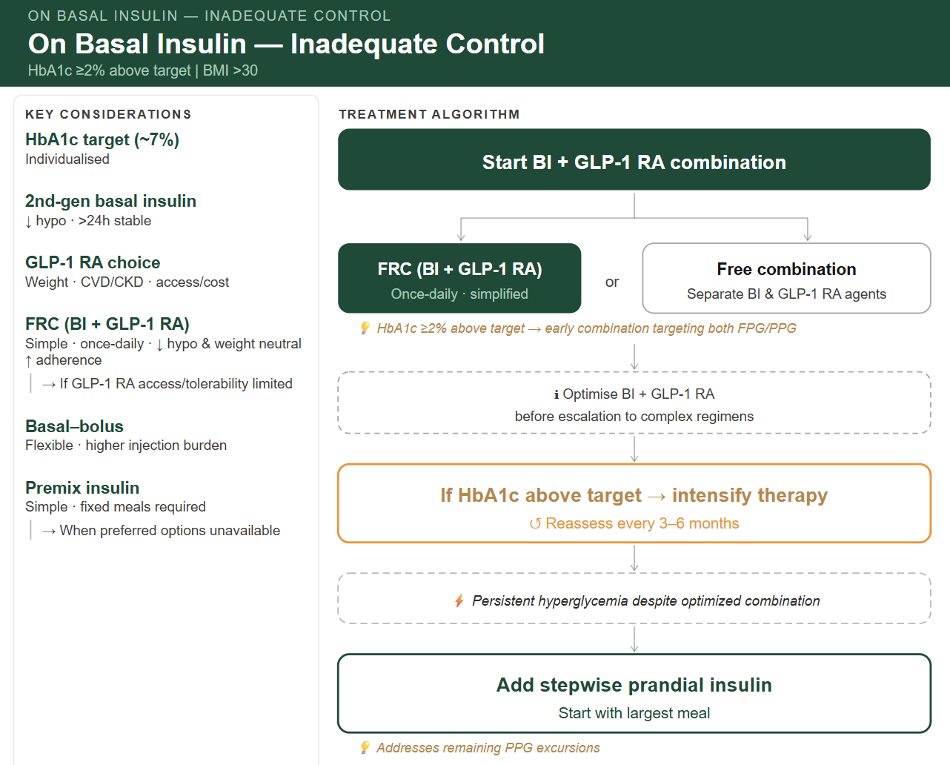
On basal insulin - Inadequate control
HbA1c ≥2% above target | BMI >30
🧠 RECOMMENDATION
🟩 Start BI + GLP-1 RA combination
FRC (BI + GLP-1 RA) – Once daily- simplified
Or free combination - Separate BI & GLP-1 RA
💡 HbA1c ≥2% above target → early combination targeting both FPG/PPG
Optimize BI + GLP-1 RA before escalation to complex regimens
🟨 If HbA1c Above Target → Intensify
↺ Reassess every 3–6 months
⚡ Persistent hyperglycemia despite optimized combination
🟩 Add stepwise prandial insulin (start with largest meal)
💡 Addresses remaining PPG excursions
🔹 Key Considerations
🧪 HbA1c target (~7%): Individualized
💉 2nd‑gen basal insulin:↓ hypo · >24h stable
⚖️ GLP‑1 RA choice: → Weight · CVD/CKD · access/cost
🔗 FRC (BI + GLP‑1 RA): Simple · once daily · ↓ hypo · weight neutral · ↑ adherence → Consider when GLP‑1 RA access or tolerability is limited
🔄 Basal–bolus: Flexible · higher injection burden
⚖️ Premix insulin: Simple · fixed meals required → Alternative when preferred options are unavailable
Notes:
Clinical alignment, clarity, actionable

Slide 35
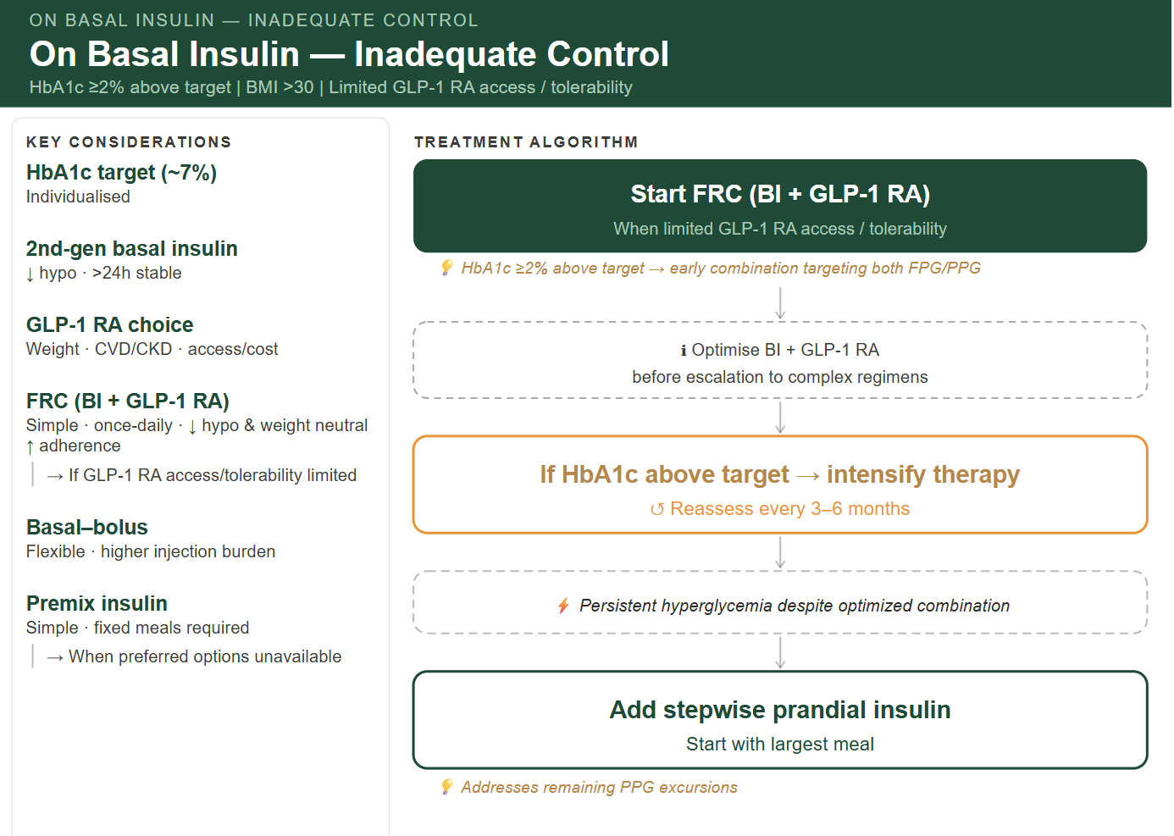
On basal insulin - Inadequate control
HbA1c ≥2% above target | BMI >30
Limited GLP-1 RA access / tolerability
🧠 RECOMMENDATION
🟩 Start FRC (BI + GLP-1 RA) – (preferred when limited GLP-1 RA access/ tolerability)
💡 HbA1c ≥2% above target → early combination targeting both FPG/PPG
Optimize BI + GLP-1 RA before escalation to complex regimens
🟨 If HbA1c Above Target → Intensify
↺ Reassess every 3–6 months
⚡ Persistent hyperglycemia despite optimized combination
🟩 Add stepwise prandial insulin (start with largest meal)
💡 Addresses remaining PPG excursions
🔹 Key Considerations
🧪 HbA1c target (~7%): Individualized
💉 2nd‑gen basal insulin:↓ hypo · >24h stable
⚖️ GLP‑1 RA choice: → Weight · CVD/CKD · access/cost
🔗 FRC (BI + GLP‑1 RA): Simple · once daily · ↓ hypo · weight neutral · ↑ adherence → Consider when GLP‑1 RA access or tolerability is limited
🔄 Basal–bolus: Flexible · higher injection burden
⚖️ Premix insulin: Simple · fixed meals required → Alternative when preferred options are unavailable
Notes:
Clinical alignment, clarity, actionable

Slide 36
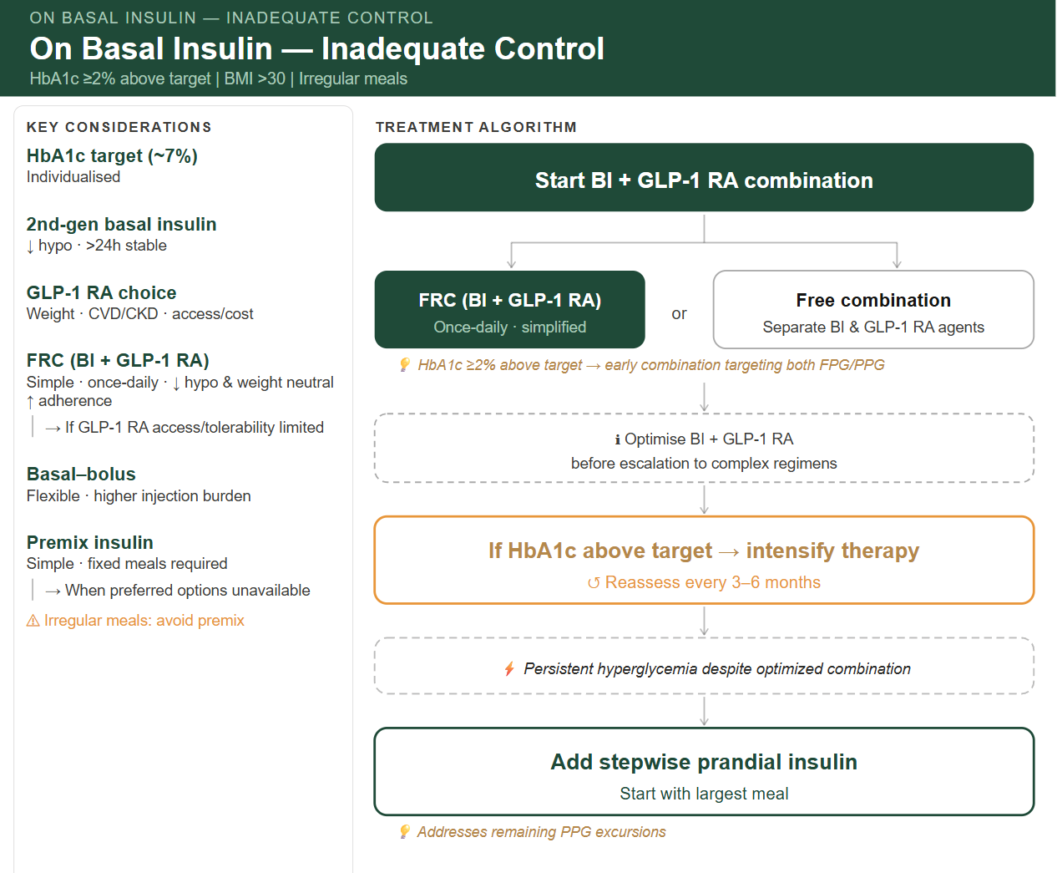
On basal insulin - Inadequate control
HbA1c ≥2% above target | BMI >30 | irregular meals
🧠 RECOMMENDATION
🟩 Start BI + GLP-1 RA combination
FRC (BI + GLP-1 RA) – Once daily- simplified
Or free combination - Separate BI & GLP-1 RA
💡 HbA1c ≥2% above target → early combination targeting both FPG/PPG
Optimize BI + GLP-1 RA before escalation to complex regimens
🟨 If HbA1c Above Target → Intensify
↺ Reassess every 3–6 months
⚡ Persistent hyperglycemia despite optimized combination
🟩 Add stepwise prandial insulin (start with largest meal)
💡 Addresses remaining PPG excursions
🔹 Key Considerations
🧪 HbA1c target (~7%): Individualized
💉 2nd‑gen basal insulin:↓ hypo · >24h stable
⚖️ GLP‑1 RA choice: → Weight · CVD/CKD · access/cost
🔗 FRC (BI + GLP‑1 RA): Simple · once daily · ↓ hypo · weight neutral · ↑ adherence → Consider when GLP‑1 RA access or tolerability is limited
🔄 Basal–bolus: Flexible · higher injection burden
⚖️ Premix insulin: Simple · fixed meals required → Alternative when preferred options are unavailable
⚠ Irregular meals: avoid premix
Notes:
Clinical alignment, clarity, actionable

Slide 37
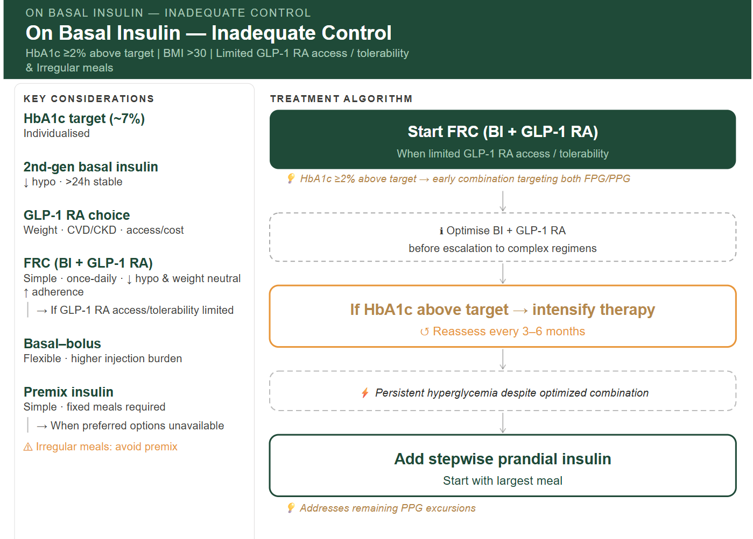
On basal insulin - Inadequate control
HbA1c ≥2% above target | BMI >30
Limited GLP-1 RA access / tolerability & irregular meals
🧠 RECOMMENDATION
🟩 Start FRC (BI + GLP-1 RA) – (preferred when limited GLP-1 RA access/ tolerability)
💡 HbA1c ≥2% above target → early combination targeting both FPG/PPG
Optimize BI + GLP-1 RA before escalation to complex regimens
🟨 If HbA1c Above Target → Intensify
↺ Reassess every 3–6 months
⚡ Persistent hyperglycemia despite optimized combination
🟩 Add stepwise prandial insulin (start with largest meal)
💡 Addresses remaining PPG excursions
🔹 Key Considerations
🧪 HbA1c target (~7%): Individualized
💉 2nd‑gen basal insulin:↓ hypo · >24h stable
⚖️ GLP‑1 RA choice: → Weight · CVD/CKD · access/cost
🔗 FRC (BI + GLP‑1 RA): Simple · once daily · ↓ hypo · weight neutral · ↑ adherence → Consider when GLP‑1 RA access or tolerability is limited
🔄 Basal–bolus: Flexible · higher injection burden
⚖️ Premix insulin: Simple · fixed meals required → Alternative when preferred options are unavailable
⚠ Irregular meals: avoid premix
Notes:
Clinical alignment, clarity, actionable

Slide 38
T2D Injectable Therapy CDS
On GLP1-RA Inadequate control

Slide 39
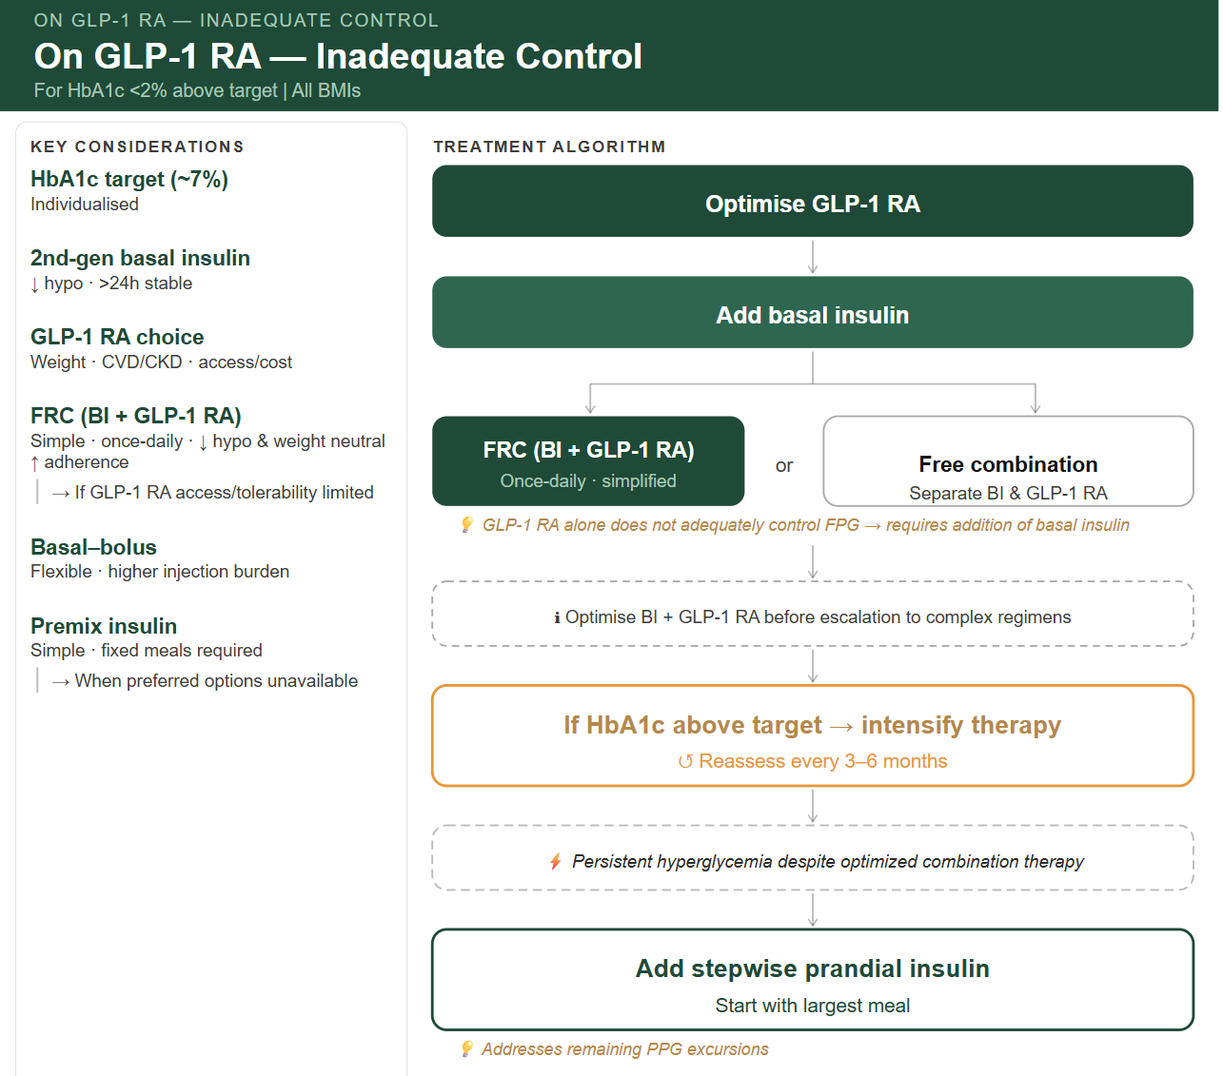
On GLP1-RA - Inadequate Control
For HbA1c <2% above target | All BMIs
🧠 RECOMMENDATION
🟩 Optimize GLP‑1 RA
🟩 Add basal insulin as:
FRC (BI + GLP-1 RA) – Once daily- simplified
Or free combination - Separate BI & GLP-1 RA
💡 GLP‑1 RA alone does not adequately control FPG→ requires addition of basal insulin
Optimize BI + GLP-1 RA combination before escalation to complex regimens
🟨 If HbA1c Above Target → Intensify
↺ Reassess every 3–6 months
⚡ Persistent hyperglycemia despite optimized combination therapy
🟩 Add stepwise prandial insulin (start with largest meal)
💡 Addresses remaining PPG excursions
🔹 Key Considerations
🧪 HbA1c target (~7%): Individualized
💉 2nd‑gen basal insulin:↓ hypo · >24h stable
⚖️ GLP‑1 RA choice: → Weight · CVD/CKD · access/cost
🔗 FRC (BI + GLP‑1 RA): Simple · once daily · ↓ hypo · weight neutral · ↑ adherence → Consider when GLP‑1 RA access or tolerability is limited
🔄 Basal–bolus: Flexible · higher injection burden
⚖️ Premix insulin: Simple · fixed meals required → Alternative when preferred options are unavailable
Notes:
depends on access to GLP1 RA

Slide 40
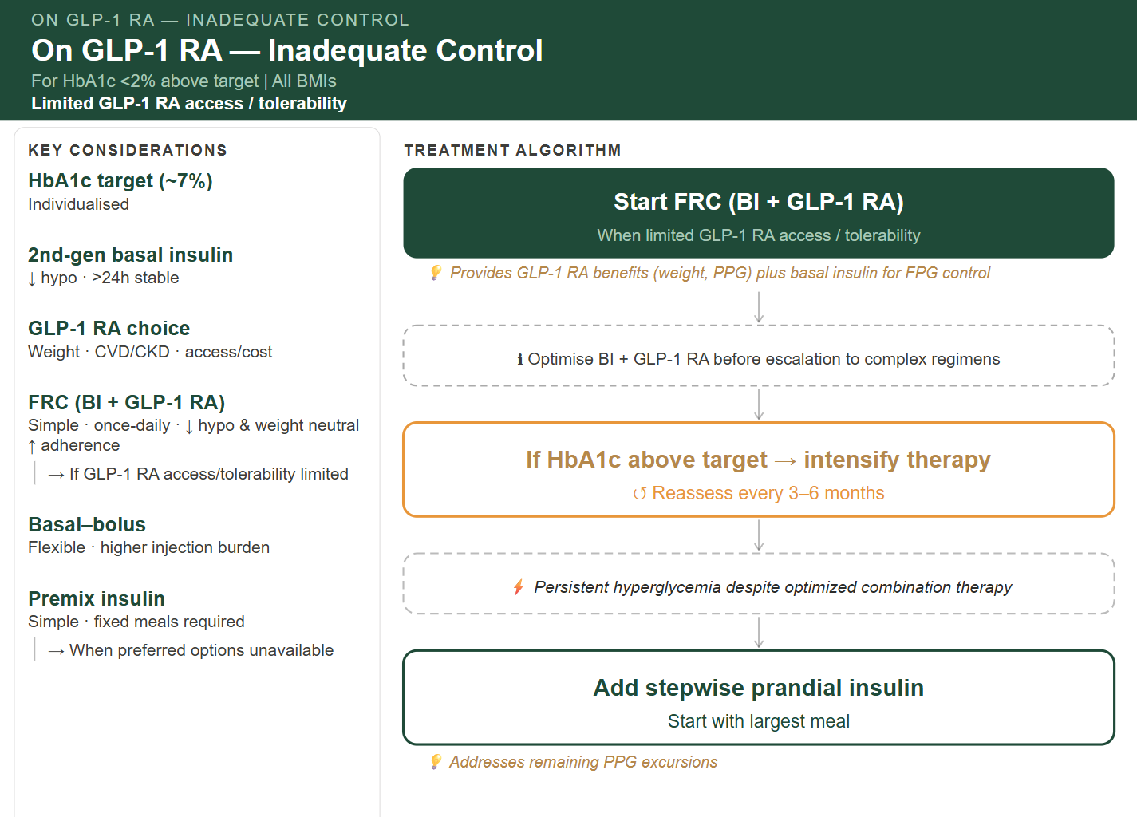
On GLP1-RA - Inadequate Control
For HbA1c <2% above target | All BMIs
Limited GLP-1 RA access / tolerability
🧠 RECOMMENDATION
🟩 Start FRC (BI + GLP-1 RA) (preferred when limited GLP-1 RA access/ tolerability)
💡 Provides GLP‑1 RA benefits (weight, PPG) plus basal insulin for FPG control
Optimize BI + GLP-1 RA before escalation to complex regimens
🟨 If HbA1c Above Target → Intensify
↺ Reassess every 3–6 months
⚡ Persistent hyperglycemia despite optimized combination therapy
🟩 Add stepwise prandial insulin (start with largest meal)
💡 Addresses remaining PPG excursions
🔹 Key Considerations
🧪 HbA1c target (~7%): Individualized
💉 2nd‑gen basal insulin:↓ hypo · >24h stable
⚖️ GLP‑1 RA choice: → Weight · CVD/CKD · access/cost
🔗 FRC (BI + GLP‑1 RA): Simple · once daily · ↓ hypo · weight neutral · ↑ adherence → Consider when GLP‑1 RA access or tolerability is limited
🔄 Basal–bolus: Flexible · higher injection burden
⚖️ Premix insulin: Simple · fixed meals required → Alternative when preferred options are unavailable
Notes:
depends on access to GLP1 RA

Slide 41

On GLP1-RA - Inadequate Control
For HbA1c <2% above target | All BMIs
Irregular meal
🧠 RECOMMENDATION
🟩 Optimize GLP‑1 RA
🟩 Add basal insulin as:
FRC (BI + GLP-1 RA) – Once daily- simplified
Or free combination - Separate BI & GLP-1 RA
💡 GLP‑1 RA alone does not adequately control FPG→ requires addition of basal insulin
Optimize BI + GLP-1 RA combination before escalation to complex regimens
🟨 If HbA1c Above Target → Intensify
↺ Reassess every 3–6 months
⚡ Persistent hyperglycemia despite optimized combination therapy
🟩 Add stepwise prandial insulin (start with largest meal)
💡 Addresses remaining PPG excursions
🔹 Key Considerations
🧪 HbA1c target (~7%): Individualized
💉 2nd‑gen basal insulin:↓ hypo · >24h stable
⚖️ GLP‑1 RA choice: → Weight · CVD/CKD · access/cost
🔗 FRC (BI + GLP‑1 RA): Simple · once daily · ↓ hypo · weight neutral · ↑ adherence → Consider when GLP‑1 RA access or tolerability is limited
🔄 Basal–bolus: Flexible · higher injection burden
⚖️ Premix insulin: Simple · fixed meals required → Alternative when preferred options are unavailable
⚠ Irregular meals: avoid premix
Notes:
Clinical alignment, clarity, actionable

Slide 42

On GLP1-RA - Inadequate Control
For HbA1c <2% above target | All BMIs
Limited GLP-1 RA access / tolerability & irregular meal
🧠 RECOMMENDATION
🟩 Start FRC (BI + GLP-1 RA) (preferred when limited GLP-1 RA access/ tolerability)
💡 Provides GLP‑1 RA benefits (weight, PPG) plus basal insulin for FPG control
Optimize BI + GLP-1 RA before escalation to complex regimens
🟨 If HbA1c Above Target → Intensify
↺ Reassess every 3–6 months
⚡ Persistent hyperglycemia despite optimized combination therapy
🟩 Add stepwise prandial insulin (start with largest meal)
💡 Addresses remaining PPG excursions
🔹 Key Considerations
🧪 HbA1c target (~7%): Individualized
💉 2nd‑gen basal insulin:↓ hypo · >24h stable
⚖️ GLP‑1 RA choice: → Weight · CVD/CKD · access/cost
🔗 FRC (BI + GLP‑1 RA): Simple · once daily · ↓ hypo · weight neutral · ↑ adherence → Consider when GLP‑1 RA access or tolerability is limited
🔄 Basal–bolus: Flexible · higher injection burden
⚖️ Premix insulin: Simple · fixed meals required → Alternative when preferred options are unavailable
⚠ Irregular meals: avoid premix
Notes:
depends on access to GLP1 RA

Slide 43
On GLP-1 RA - Inadequate control
HbA1c ≥2% above target | BMI ≤30
🧠 RECOMMENDATION
🟩 Start BI + GLP-1 RA combination
FRC (BI + GLP-1 RA) – Once daily- simplified
Or free combination - Separate BI & GLP-1 RA
💡 HbA1c ≥2% above target → early combination targeting both FPG/PPG
Optimize BI + GLP-1 RA before escalation to complex regimens
🟩Alternative: premix insulin (when FRC/free combination unavailable)
🟨 If HbA1c Above Target → Intensify
↺ Reassess every 3–6 months
⚡ Persistent hyperglycemia despite optimized combination
🟩 Add stepwise prandial insulin (start with largest meal)
💡 Addresses remaining PPG excursions
🔹 Key Considerations
🧪 HbA1c target (~7%): Individualized
💉 2nd‑gen basal insulin:↓ hypo · >24h stable
⚖️ GLP‑1 RA choice: → Weight · CVD/CKD · access/cost
🔗 FRC (BI + GLP‑1 RA): Simple · once daily · ↓ hypo · weight neutral · ↑ adherence → Consider when GLP‑1 RA access or tolerability is limited
🔄 Basal–bolus: Flexible · higher injection burden
⚖️ Premix insulin: Simple · fixed meals required → Alternative when preferred options are unavailable
Notes:
Clinical alignment, clarity, actionable

Slide 44
On GLP-1 RA - Inadequate control
HbA1c ≥2% above target | BMI ≤30
Limited GLP-1 RA access / tolerability
🧠 RECOMMENDATION
🟩 Start FRC (BI + GLP-1 RA) – (preferred when limited GLP-1 RA access/ tolerability)
💡 HbA1c ≥2% above target → early combination targeting both FPG/PPG
Optimize BI + GLP-1 RA before escalation to complex regimens
🟩Alternative: premix insulin (when FRC/free combination unavailable)
🟨 If HbA1c Above Target → Intensify
↺ Reassess every 3–6 months
⚡ Persistent hyperglycemia despite optimized combination
🟩 Add stepwise prandial insulin (start with largest meal)
💡 Addresses remaining PPG excursions
🔹 Key Considerations
🧪 HbA1c target (~7%): Individualized
💉 2nd‑gen basal insulin:↓ hypo · >24h stable
⚖️ GLP‑1 RA choice: → Weight · CVD/CKD · access/cost
🔗 FRC (BI + GLP‑1 RA): Simple · once daily · ↓ hypo · weight neutral · ↑ adherence → Consider when GLP‑1 RA access or tolerability is limited
🔄 Basal–bolus: Flexible · higher injection burden
⚖️ Premix insulin: Simple · fixed meals required → Alternative when preferred options are unavailable
Notes:
Clinical alignment, clarity, actionable

Slide 45
On GLP-1 RA - Inadequate control
HbA1c ≥2% above target | BMI ≤30 | irregular meals
🧠 RECOMMENDATION
🟩 Start BI + GLP-1 RA combination
FRC (BI + GLP-1 RA) – Once daily- simplified
Or free combination - Separate BI & GLP-1 RA
💡 HbA1c ≥2% above target → early combination targeting both FPG/PPG
Optimize BI + GLP-1 RA before escalation to complex regimens
🟨 If HbA1c Above Target → Intensify
↺ Reassess every 3–6 months
⚡ Persistent hyperglycemia despite optimized combination
🟩 Add stepwise prandial insulin (start with largest meal)
💡 Addresses remaining PPG excursions
🔹 Key Considerations
🧪 HbA1c target (~7%): Individualized
💉 2nd‑gen basal insulin:↓ hypo · >24h stable
⚖️ GLP‑1 RA choice: → Weight · CVD/CKD · access/cost
🔗 FRC (BI + GLP‑1 RA): Simple · once daily · ↓ hypo · weight neutral · ↑ adherence → Consider when GLP‑1 RA access or tolerability is limited
🔄 Basal–bolus: Flexible · higher injection burden
⚖️ Premix insulin: Simple · fixed meals required → Alternative when preferred options are unavailable
⚠ Irregular meals: avoid premix
Notes:
Clinical alignment, clarity, actionable

Slide 46
On GLP-1 RA - Inadequate control
HbA1c ≥2% above target | BMI ≤30 |
Limited GLP-1 RA access / tolerability & irregular meals
🧠 RECOMMENDATION
🟩 Start FRC (BI + GLP-1 RA) – (preferred when limited GLP-1 RA access/ tolerability)
💡 HbA1c ≥2% above target → early combination targeting both FPG/PPG
Optimize BI + GLP-1 RA before escalation to complex regimens
🟨 If HbA1c Above Target → Intensify
↺ Reassess every 3–6 months
⚡ Persistent hyperglycemia despite optimized combination
🟩 Add stepwise prandial insulin (start with largest meal)
💡 Addresses remaining PPG excursions
🔹 Key Considerations
🧪 HbA1c target (~7%): Individualized
💉 2nd‑gen basal insulin:↓ hypo · >24h stable
⚖️ GLP‑1 RA choice: → Weight · CVD/CKD · access/cost
🔗 FRC (BI + GLP‑1 RA): Simple · once daily · ↓ hypo · weight neutral · ↑ adherence → Consider when GLP‑1 RA access or tolerability is limited
🔄 Basal–bolus: Flexible · higher injection burden
⚖️ Premix insulin: Simple · fixed meals required → Alternative when preferred options are unavailable
⚠ Irregular meals: avoid premix
Notes:
Clinical alignment, clarity, actionable

Slide 47
On GLP-1 RA - Inadequate control
HbA1c ≥2% above target | BMI >30
🧠 RECOMMENDATION
🟩 Start BI + GLP-1 RA combination
FRC (BI + GLP-1 RA) – Once daily- simplified
Or free combination - Separate BI & GLP-1 RA
💡 HbA1c ≥2% above target → early combination targeting both FPG/PPG
Optimize BI + GLP-1 RA before escalation to complex regimens
🟨 If HbA1c Above Target → Intensify
↺ Reassess every 3–6 months
⚡ Persistent hyperglycemia despite optimized combination
🟩 Add stepwise prandial insulin (start with largest meal)
💡 Addresses remaining PPG excursions
🔹 Key Considerations
🧪 HbA1c target (~7%): Individualized
💉 2nd‑gen basal insulin:↓ hypo · >24h stable
⚖️ GLP‑1 RA choice: → Weight · CVD/CKD · access/cost
🔗 FRC (BI + GLP‑1 RA): Simple · once daily · ↓ hypo · weight neutral · ↑ adherence → Consider when GLP‑1 RA access or tolerability is limited
🔄 Basal–bolus: Flexible · higher injection burden
⚖️ Premix insulin: Simple · fixed meals required → Alternative when preferred options are unavailable
Notes:
Clinical alignment, clarity, actionable

Slide 48
On GLP-1 RA - Inadequate control
HbA1c ≥2% above target | BMI >30
Limited GLP-1 RA access / tolerability
🧠 RECOMMENDATION
🟩 Start FRC (BI + GLP-1 RA) – (preferred when limited GLP-1 RA access/ tolerability)
💡 HbA1c ≥2% above target → early combination targeting both FPG/PPG
Optimize BI + GLP-1 RA before escalation to complex regimens
🟨 If HbA1c Above Target → Intensify
↺ Reassess every 3–6 months
⚡ Persistent hyperglycemia despite optimized combination
🟩 Add stepwise prandial insulin (start with largest meal)
💡 Addresses remaining PPG excursions
🔹 Key Considerations
🧪 HbA1c target (~7%): Individualized
💉 2nd‑gen basal insulin:↓ hypo · >24h stable
⚖️ GLP‑1 RA choice: → Weight · CVD/CKD · access/cost
🔗 FRC (BI + GLP‑1 RA): Simple · once daily · ↓ hypo · weight neutral · ↑ adherence → Consider when GLP‑1 RA access or tolerability is limited
🔄 Basal–bolus: Flexible · higher injection burden
⚖️ Premix insulin: Simple · fixed meals required → Alternative when preferred options are unavailable
Notes:
Clinical alignment, clarity, actionable

Slide 49
On GLP-1 RA - Inadequate control
HbA1c ≥2% above target | BMI >30 | irregular meals
🧠 RECOMMENDATION
🟩 Start BI + GLP-1 RA combination
FRC (BI + GLP-1 RA) – Once daily- simplified
Or free combination - Separate BI & GLP-1 RA
💡 HbA1c ≥2% above target → early combination targeting both FPG/PPG
Optimize BI + GLP-1 RA before escalation to complex regimens
🟨 If HbA1c Above Target → Intensify
↺ Reassess every 3–6 months
⚡ Persistent hyperglycemia despite optimized combination
🟩 Add stepwise prandial insulin (start with largest meal)
💡 Addresses remaining PPG excursions
🔹 Key Considerations
🧪 HbA1c target (~7%): Individualized
💉 2nd‑gen basal insulin:↓ hypo · >24h stable
⚖️ GLP‑1 RA choice: → Weight · CVD/CKD · access/cost
🔗 FRC (BI + GLP‑1 RA): Simple · once daily · ↓ hypo · weight neutral · ↑ adherence → Consider when GLP‑1 RA access or tolerability is limited
🔄 Basal–bolus: Flexible · higher injection burden
⚖️ Premix insulin: Simple · fixed meals required → Alternative when preferred options are unavailable
⚠ Irregular meals: avoid premix
Notes:
Clinical alignment, clarity, actionable

Slide 50
On GLP-1 RA - Inadequate control
HbA1c ≥2% above target | BMI >30
Limited GLP-1 RA access / tolerability & irregular meals
🧠 RECOMMENDATION
🟩 Start FRC (BI + GLP-1 RA) – (preferred when limited GLP-1 RA access/ tolerability)
💡 HbA1c ≥2% above target → early combination targeting both FPG/PPG
Optimize BI + GLP-1 RA before escalation to complex regimens
🟨 If HbA1c Above Target → Intensify
↺ Reassess every 3–6 months
⚡ Persistent hyperglycemia despite optimized combination
🟩 Add stepwise prandial insulin (start with largest meal)
💡 Addresses remaining PPG excursions
🔹 Key Considerations
🧪 HbA1c target (~7%): Individualized
💉 2nd‑gen basal insulin:↓ hypo · >24h stable
⚖️ GLP‑1 RA choice: → Weight · CVD/CKD · access/cost
🔗 FRC (BI + GLP‑1 RA): Simple · once daily · ↓ hypo · weight neutral · ↑ adherence → Consider when GLP‑1 RA access or tolerability is limited
🔄 Basal–bolus: Flexible · higher injection burden
⚖️ Premix insulin: Simple · fixed meals required → Alternative when preferred options are unavailable
⚠ Irregular meals: avoid premix
Notes:
Clinical alignment, clarity, actionable

Slide 51

After BI + GLP-1 RA (FRC or separately) Inadequate control Regardless of HbA1c & BMI

Slide 52
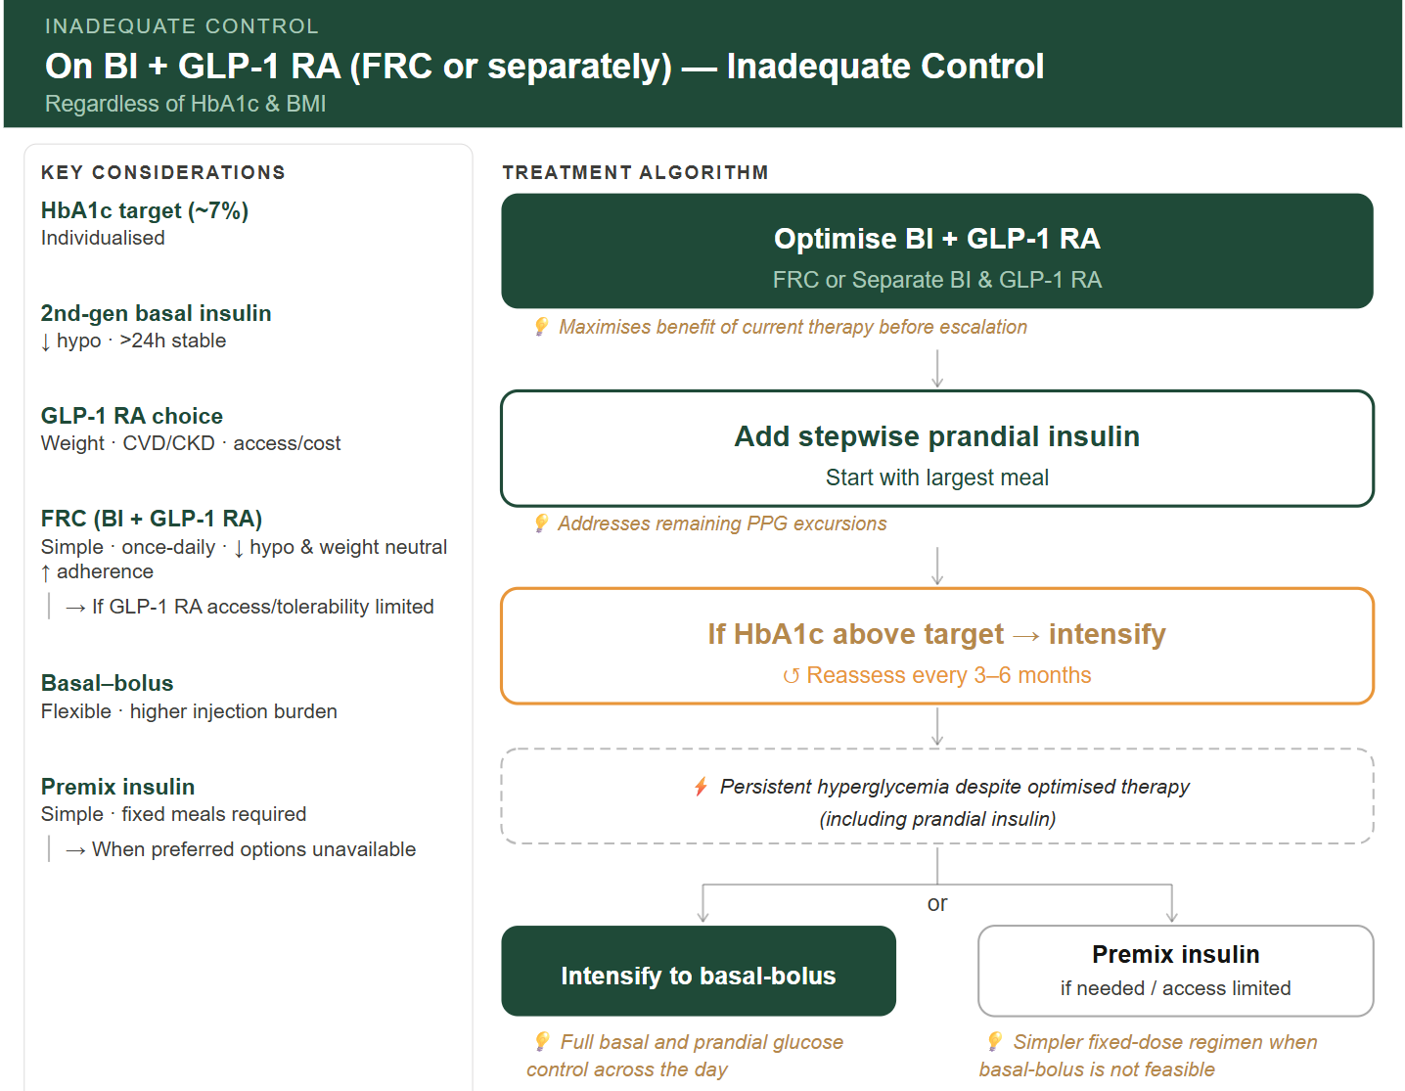
On BI + GLP1-RA (FRC or separately) - Inadequate Control
Regardless of HbA1c & BMI
🧠 RECOMMENDATION
🟩 Optimize BI + GLP-1 RA (FRC or Separate BI & GLP-1 RA)
💡 Ensures optimization of current therapy before escalation to complex regimens
🟩 Add stepwise prandial insulin (start with largest meal)
💡 Addresses remaining PPG excursions
🟨 If HbA1c Above Target → Intensify
↺ Reassess every 3–6 months
⚡ Persistent hyperglycemia despite optimized therapy (including prandial insulin)
🟩 Intensify to basal-bolus
💡 Full basal and prandial glucose control across the day
🟩 Alternative: premix insulin (if needed / access limited)
💡 Simpler fixed-dose regimen when basal‑bolus is not feasible
🔹 Key Considerations
🧪 HbA1c target (~7%): Individualized
💉 2nd‑gen basal insulin:↓ hypo · >24h stable
⚖️ GLP‑1 RA choice: → Weight · CVD/CKD · access/cost
🔗 FRC (BI + GLP‑1 RA): Simple · once daily · ↓ hypo · weight neutral · ↑ adherence → Consider when GLP‑1 RA access or tolerability is limited
🔄 Basal–bolus: Flexible · higher injection burden
⚖️ Premix insulin: Simple · fixed meals required → Alternative when preferred options are unavailable
Notes:
Basal insulin → FPG control GLP‑1 RA → PPG and weight Prandial insulin → residual hyperglycemia

Slide 53
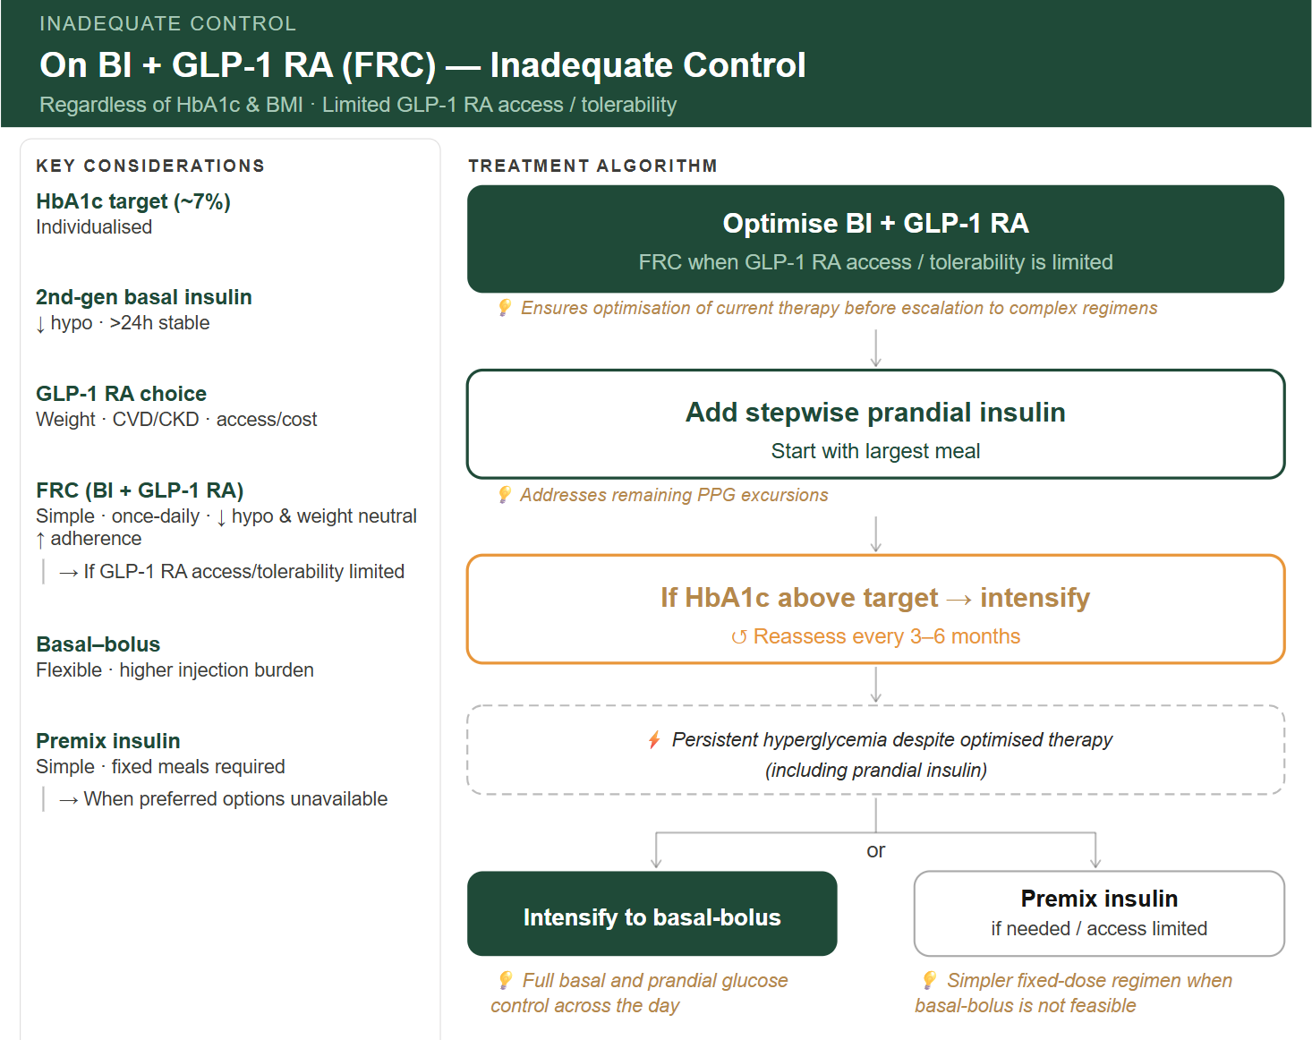
On BI + GLP1-RA (FRC) - Inadequate Control
Regardless of HbA1c & BMI
Limited GLP-1 RA access / tolerability
🧠 RECOMMENDATION
🟩 Optimize BI + GLP-1 RA – (FRC preferred when limited GLP-1 RA access/ tolerability)
💡 Ensures optimization of current therapy before escalation to complex regimens
🟩 Add stepwise prandial insulin (start with largest meal)
💡 Addresses remaining PPG excursions
🟨 If HbA1c Above Target → Intensify
↺ Reassess every 3–6 months
⚡ Persistent hyperglycemia despite optimized therapy (including prandial insulin)
🟩 Intensify to basal-bolus
💡 Full basal and prandial glucose control across the day
🟩 Alternative: premix insulin (if needed / access limited)
💡 Simpler fixed-dose regimen when basal‑bolus is not feasible
🔹 Key Considerations
🧪 HbA1c target (~7%): Individualized
💉 2nd‑gen basal insulin:↓ hypo · >24h stable
⚖️ GLP‑1 RA choice: → Weight · CVD/CKD · access/cost
🔗 FRC (BI + GLP‑1 RA): Simple · once daily · ↓ hypo · weight neutral · ↑ adherence → Consider when GLP‑1 RA access or tolerability is limited
🔄 Basal–bolus: Flexible · higher injection burden
⚖️ Premix insulin: Simple · fixed meals required → Alternative when preferred options are unavailable
Notes:
Clinical alignment, clarity, actionable

Slide 54
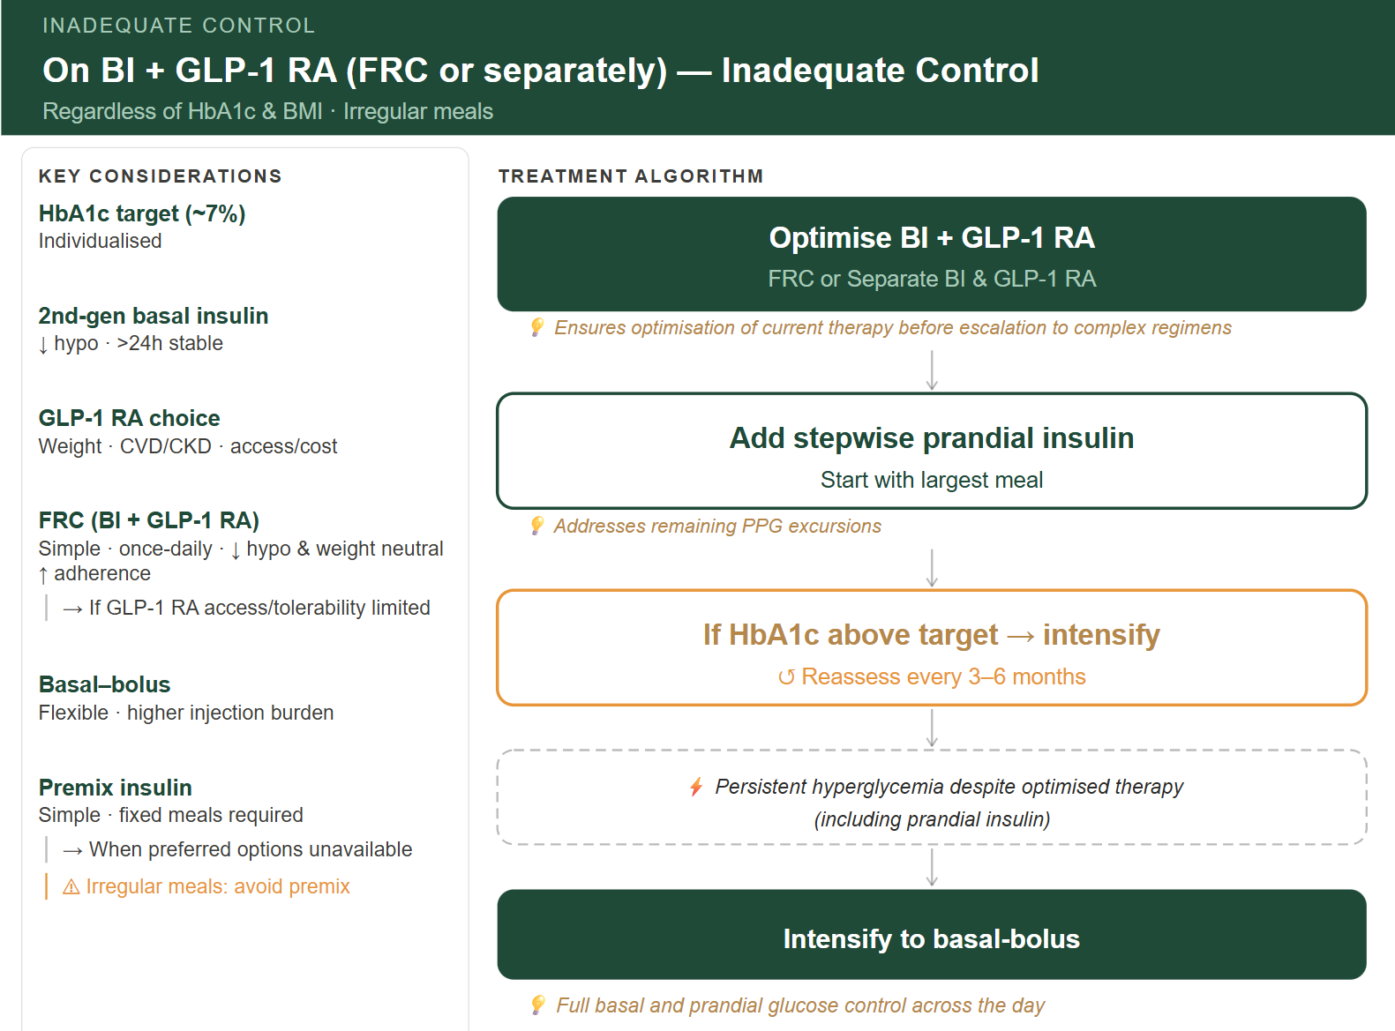
On BI + GLP1-RA (FRC or separately) - Inadequate Control
Regardless of HbA1c & BMI
Irregular meals
🧠 RECOMMENDATION
🟩 Optimize BI + GLP-1 RA (FRC or Separate BI & GLP-1 RA)
💡 Ensures optimization of current therapy before escalation to complex regimens
🟩 Add stepwise prandial insulin (start with largest meal)
💡 Addresses remaining PPG excursions
🟨 If HbA1c Above Target → Intensify
↺ Reassess every 3–6 months
⚡ Persistent hyperglycemia despite optimized therapy (including prandial insulin)
🟩 Intensify to basal-bolus
💡 Full basal and prandial glucose control across the day
🔹 Key Considerations
🧪 HbA1c target (~7%): Individualized
💉 2nd‑gen basal insulin:↓ hypo · >24h stable
⚖️ GLP‑1 RA choice: → Weight · CVD/CKD · access/cost
🔗 FRC (BI + GLP‑1 RA): Simple · once daily · ↓ hypo · weight neutral · ↑ adherence → Consider when GLP‑1 RA access or tolerability is limited
🔄 Basal–bolus: Flexible · higher injection burden
⚖️ Premix insulin: Simple · fixed meals required → Alternative when preferred options are unavailable
⚠ Irregular meals: avoid premix
Notes:
Basal insulin → FPG control GLP‑1 RA → PPG and weight Prandial insulin → residual hyperglycemia

Slide 55
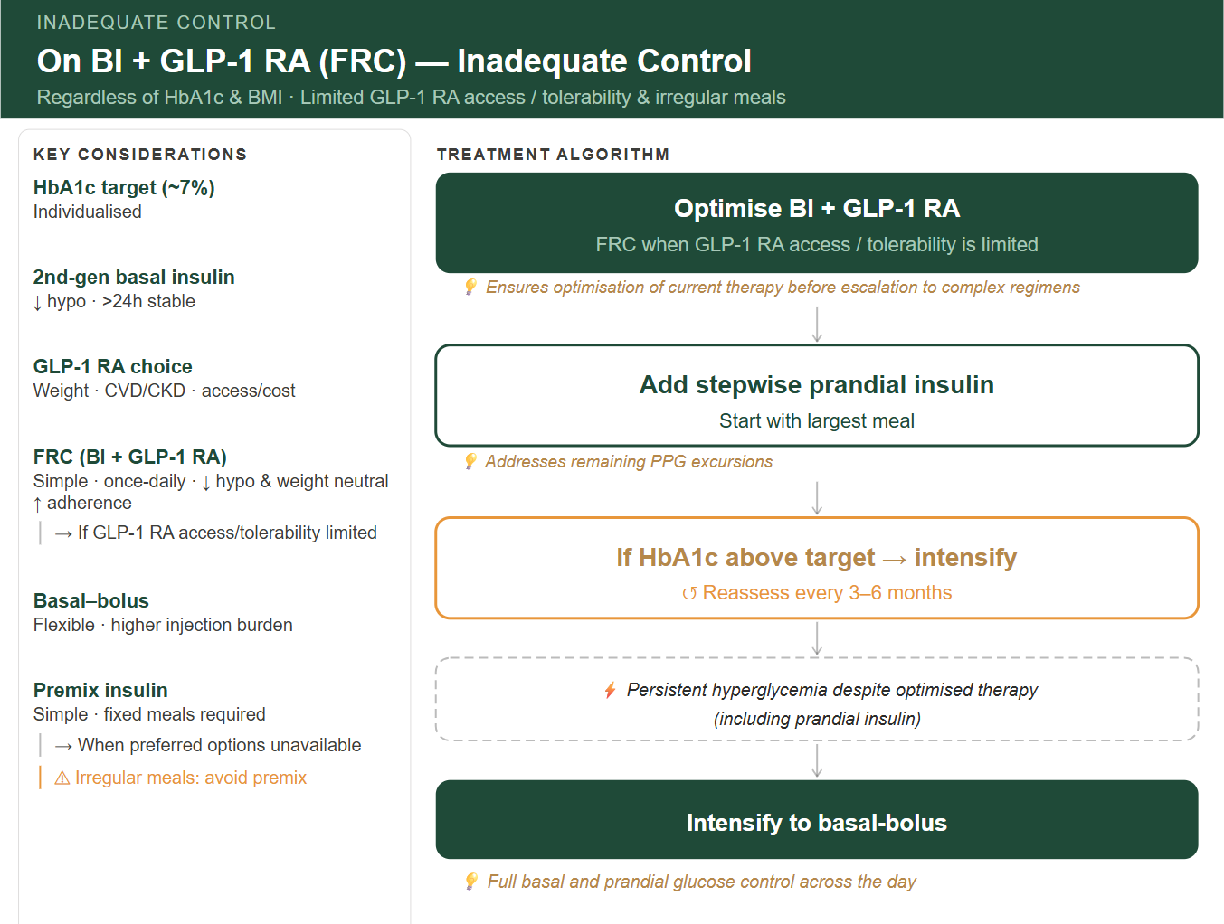
On BI + GLP1-RA (FRC) - Inadequate Control
Regardless of HbA1c & BMI
Limited GLP-1 RA access / tolerability & irregular meals
🧠 RECOMMENDATION
🟩 Optimize BI + GLP-1 RA – (FRC preferred when limited GLP-1 RA access/ tolerability)
💡 Ensures optimization of current therapy before escalation to complex regimens
🟩 Add stepwise prandial insulin (start with largest meal)
💡 Addresses remaining PPG excursions
🟨 If HbA1c Above Target → Intensify
↺ Reassess every 3–6 months
⚡ Persistent hyperglycemia despite optimized therapy (including prandial insulin)
🟩 Intensify to basal-bolus
💡 Full basal and prandial glucose control across the day
🔹 Key Considerations
🧪 HbA1c target (~7%): Individualized
💉 2nd‑gen basal insulin:↓ hypo · >24h stable
⚖️ GLP‑1 RA choice: → Weight · CVD/CKD · access/cost
🔗 FRC (BI + GLP‑1 RA): Simple · once daily · ↓ hypo · weight neutral · ↑ adherence → Consider when GLP‑1 RA access or tolerability is limited
🔄 Basal–bolus: Flexible · higher injection burden
⚖️ Premix insulin: Simple · fixed meals required → Alternative when preferred options are unavailable
⚠ Irregular meals: avoid premix
Notes:
Basal insulin → FPG control GLP‑1 RA → PPG and weight Prandial insulin → residual hyperglycemia

Slide 56

On BI + GLP-1 RA (FRC or separately) + RAI (basal plus) Inadequate control

Slide 57
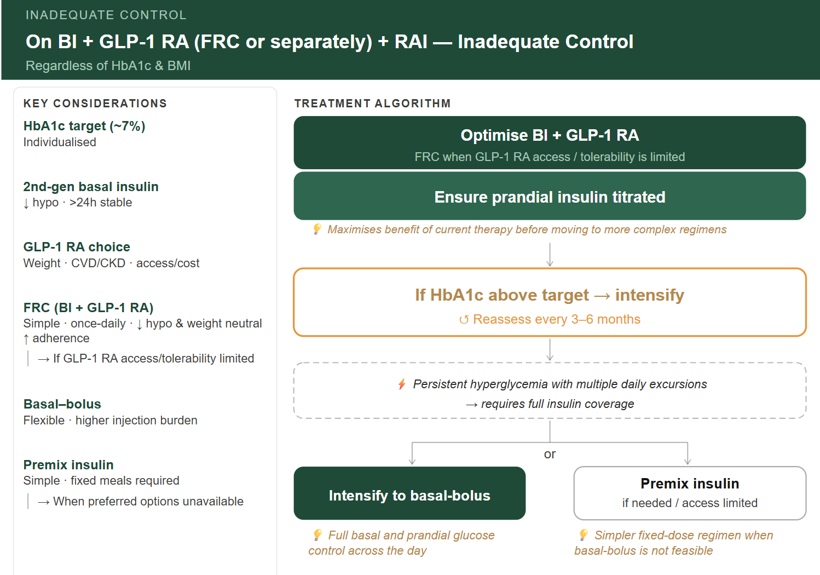
On BI + GLP1-RA (FRC or separately) + RAI - Inadequate Control
Regardless of HbA1c & BMI
🧠 RECOMMENDATION
🟩 Optimize BI + GLP-1 RA (FRC or Separate BI & GLP-1 RA) + prandial insulin
💡 Maximizes benefit of current therapy before moving to more complex regimens
🟨 If HbA1c Above Target → Intensify
↺ Reassess every 3–6 months
⚡ Persistent hyperglycemia with multiple daily excursions despite optimized therapy
→ requires full insulin coverage
🟩 Intensify to basal-bolus
💡 Full basal and prandial glucose control across the day
→ 🟩 Alternative: premix insulin (if needed / access limited)
💡 Simpler fixed-dose regimen when basal‑bolus is not feasible
🔹 Key Considerations
🧪 HbA1c target (~7%): Individualized
💉 2nd‑gen basal insulin:↓ hypo · >24h stable
⚖️ GLP‑1 RA choice: → Weight · CVD/CKD · access/cost
🔗 FRC (BI + GLP‑1 RA): Simple · once daily · ↓ hypo · weight neutral · ↑ adherence → Consider when GLP‑1 RA access or tolerability is limited
🔄 Basal–bolus: Flexible · higher injection burden
⚖️ Premix insulin: Simple · fixed meals required → Alternative when preferred options are unavailable
Notes:
Patient profile (meal pattern, hypoglycemia risk), Basal‑bolus preferred with irregular meals

Slide 58

On BI + GLP1-RA (FRC) + RAI –
Inadequate Control
Regardless of HbA1c & BMI
Limited GLP-1 RA access / tolerability
🧠 RECOMMENDATION
🟩 Optimize BI + GLP-1 RA – (FRC preferred when limited GLP-1 RA access/ tolerability)
🟩 Ensure prandial insulin titrated
💡 Maximizes benefit of current therapy before moving to more complex regimens
🟨 If HbA1c Above Target → Intensify
↺ Reassess every 3–6 months
⚡ Persistent hyperglycemia with multiple daily excursions → requires full insulin coverage
🟩 Intensify to basal-bolus
💡 Full basal and prandial glucose control across the day
→ 🟩 Alternative: premix insulin (if needed / access limited)
💡 Simpler fixed-dose regimen when basal‑bolus is not feasible
🔹 Key Considerations
🧪 HbA1c target (~7%): Individualized
💉 2nd‑gen basal insulin:↓ hypo · >24h stable
⚖️ GLP‑1 RA choice: → Weight · CVD/CKD · access/cost
🔗 FRC (BI + GLP‑1 RA): Simple · once daily · ↓ hypo · weight neutral · ↑ adherence → Consider when GLP‑1 RA access or tolerability is limited
🔄 Basal–bolus: Flexible · higher injection burden
⚖️ Premix insulin: Simple · fixed meals required → Alternative when preferred options are unavailable
Notes:
Patient profile (meal pattern, hypoglycemia risk), Basal‑bolus preferred with irregular meals

Slide 59
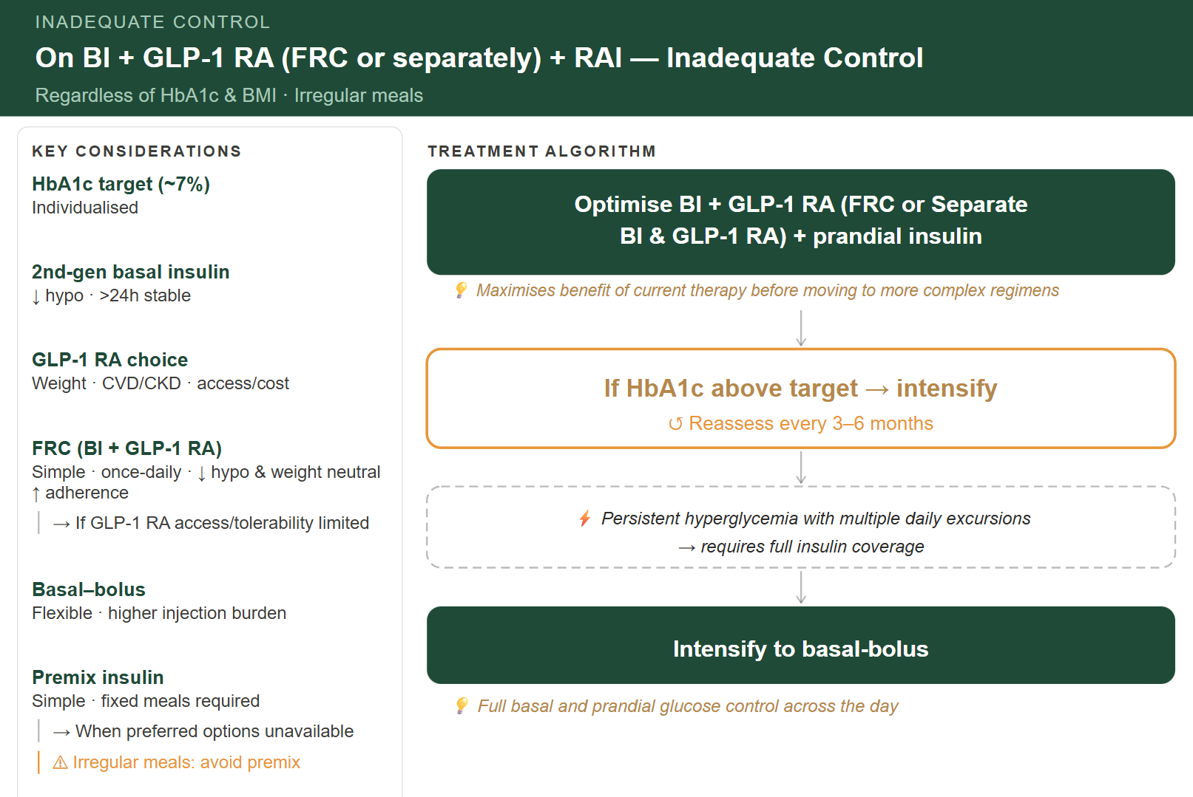
On BI + GLP1-RA (FRC or separately) + RAI - Inadequate Control
Regardless of HbA1c & BMI
irregular meal
🧠 RECOMMENDATION
🟩 Optimize BI + GLP-1 RA (FRC or Separate BI & GLP-1 RA) + prandial insulin
💡 Maximizes benefit of current therapy before moving to more complex regimens
🟨 If HbA1c Above Target → Intensify
↺ Reassess every 3–6 months
⚡ Persistent hyperglycemia with multiple daily excursions
→ requires full insulin coverage
🟩 Intensify to basal-bolus
💡 Full basal and prandial glucose control across the day
🔹 Key Considerations
🧪 HbA1c target (~7%): Individualized
💉 2nd‑gen basal insulin:↓ hypo · >24h stable
⚖️ GLP‑1 RA choice: → Weight · CVD/CKD · access/cost
🔗 FRC (BI + GLP‑1 RA): Simple · once daily · ↓ hypo · weight neutral · ↑ adherence → Consider when GLP‑1 RA access or tolerability is limited
🔄 Basal–bolus: Flexible · higher injection burden
⚖️ Premix insulin: Simple · fixed meals required → Alternative when preferred options are unavailable
⚠ Irregular meals: avoid premix
Notes:
Patient profile (meal pattern, hypoglycemia risk), Basal‑bolus preferred with irregular meals

Slide 60
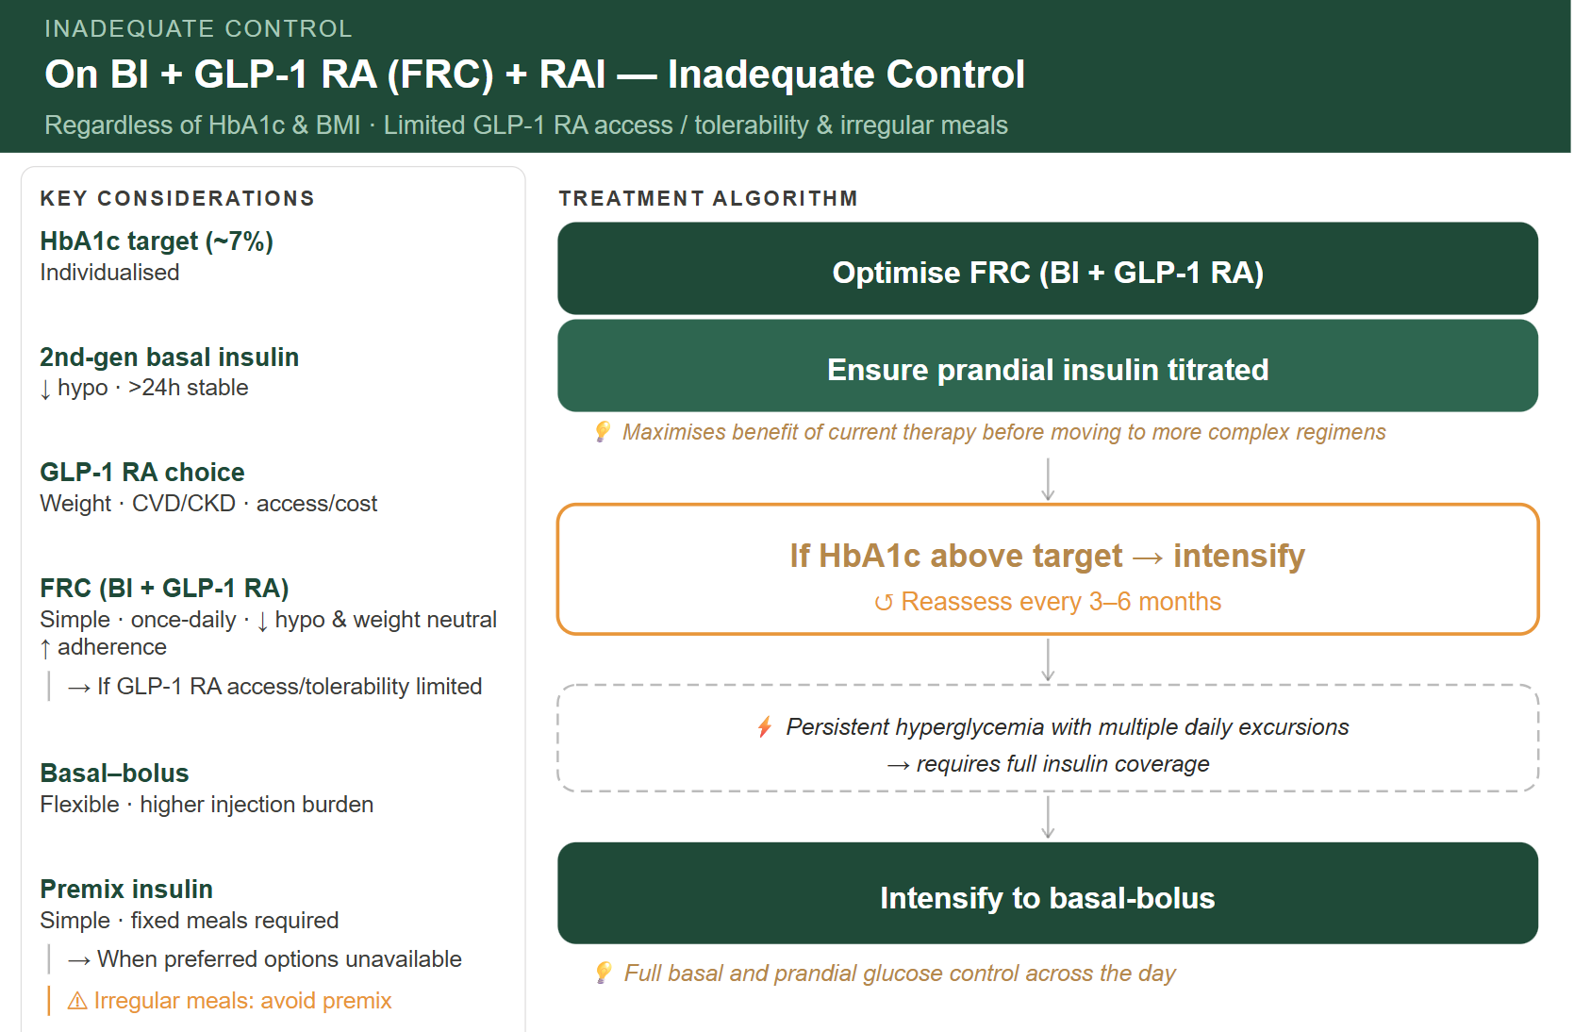
On BI + GLP1-RA (FRC) + RAI –
Inadequate Control
Regardless of HbA1c & BMI
Limited GLP-1 RA access / tolerability & irregular meal
🧠 RECOMMENDATION
🟩 Optimize FRC (BI + GLP-1 RA)
🟩 Ensure prandial insulin titrated
💡 Maximizes benefit of current therapy before moving to more complex regimens
🟨 If HbA1c Above Target → Intensify
↺ Reassess every 3–6 months
⚡ Persistent hyperglycemia with multiple daily excursions → requires full insulin coverage
🟩 Intensify to basal-bolus
💡 Full basal and prandial glucose control across the day
🔹 Key Considerations
🧪 HbA1c target (~7%): Individualized
💉 2nd‑gen basal insulin:↓ hypo · >24h stable
⚖️ GLP‑1 RA choice: → Weight · CVD/CKD · access/cost
🔗 FRC (BI + GLP‑1 RA): Simple · once daily · ↓ hypo · weight neutral · ↑ adherence → Consider when GLP‑1 RA access or tolerability is limited
🔄 Basal–bolus: Flexible · higher injection burden
⚖️ Premix insulin: Simple · fixed meals required → Alternative when preferred options are unavailable
⚠ Irregular meals: avoid premix
Notes:
Patient profile (meal pattern, hypoglycemia risk), Basal‑bolus preferred with irregular meals

Slide 61
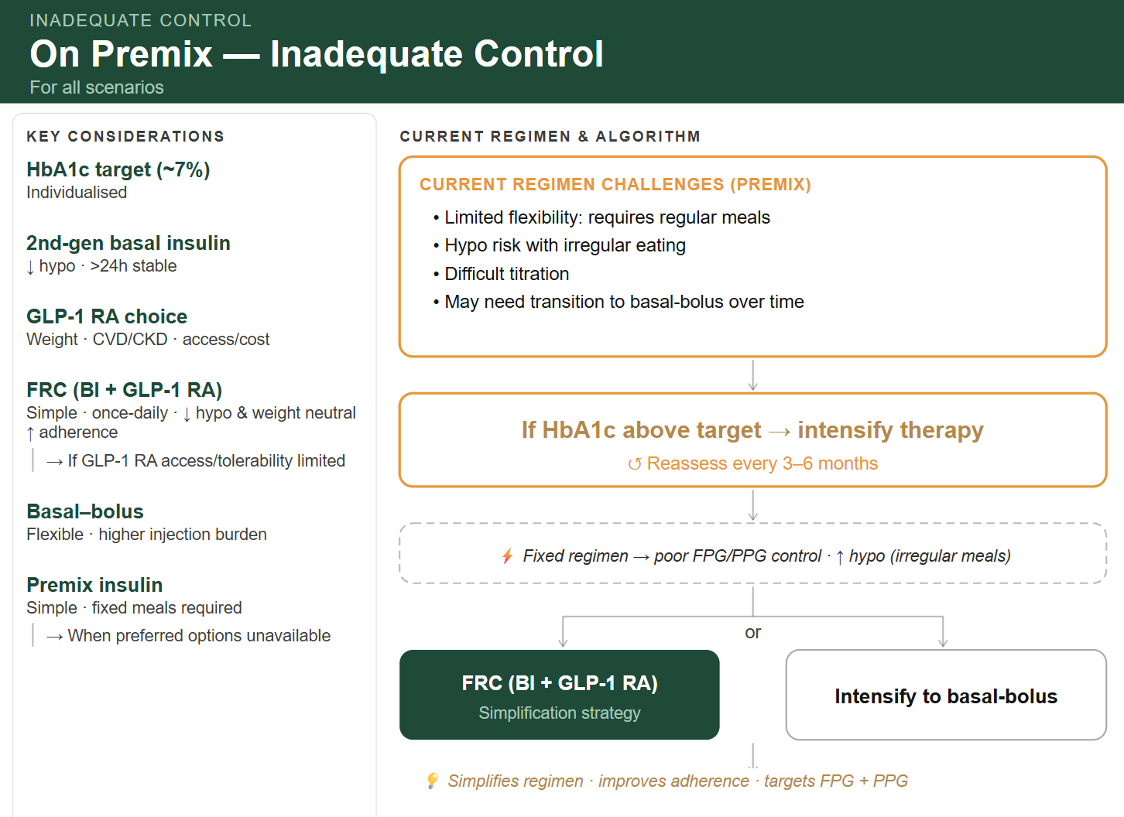
On Premix - Inadequate control Regardless of HbA1c & BMI For all scenarios
CURRENT REGIMEN CHALLENGES (PREMIX)
Limited flexibility: requires regular meals
Hypoglycemia risk with irregular eating
Difficult titration
May need transition to basal–bolus over time
🟨 If HbA1c Above Target → Intensify
↺ Reassess every 3–6 months
⚡ Fixed regimen → poor FPG / PPG control · ↑ hypo (irregular meals)
🟩 Prefer transition to FRC (BI + GLP-1 RA) where accessible (simplification strategy)
💡 Simplifies regimen· improves adherence · targets both FPG & PPG
🟩 Intensify to basal-bolus
💡 Flexible full basal and prandial glucose control across the day
🔹 Key Considerations
🧪 HbA1c target (~7%): Individualized
💉 2nd‑gen basal insulin:↓ hypo · >24h stable
⚖️ GLP‑1 RA choice: → Weight · CVD/CKD · access/cost
🔗 FRC (BI + GLP‑1 RA): Simple · once daily · ↓ hypo · weight neutral · ↑ adherence → Consider when GLP‑1 RA access or tolerability is limited
🔄 Basal–bolus: Flexible · higher injection burden
⚖️ Premix insulin: Simple · fixed meals required → Alternative when preferred options are unavailable
Notes:
WHY: Limited flexibility → suboptimal control (especially with variable meals)
premixed insulins require regular meal timing and cause hypoglycemia and weight gain
BMI >30 + GLP‑1 access → Basal + GLP‑1 (FRC)

Slide 62
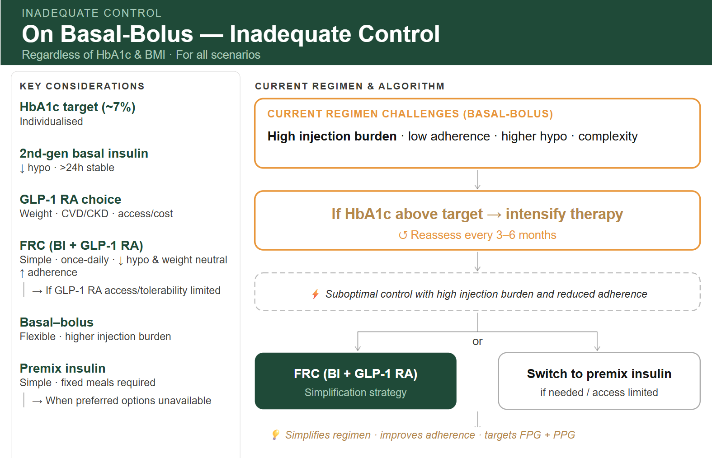
On Basal-Bolus - Inadequate control Regardless of HbA1c & BMI For all scenarios
CURRENT REGIMEN CHALLENGES (BASAL-BOLUS)
➤ High injection burden · low adherence · higher hypoglycemia · complexity
🟨 If HbA1c Above Target → Intensify
↺ Reassess every 3–6 months
⚡ Suboptimal control with high injection burden and reduced adherence
🟩 Prefer transition to FRC (BI + GLP-1 RA) where accessible (simplification strategy)
💡 Simplifies regimen · improves adherence · targets both FPG & PPG
🟩 Alternative: Switch to premix insulin (if needed / access limited)
🔹 Key Considerations
🧪 HbA1c target (~7%): Individualized
💉 2nd‑gen basal insulin:↓ hypo · >24h stable
⚖️ GLP‑1 RA choice: → Weight · CVD/CKD · access/cost
🔗 FRC (BI + GLP‑1 RA): Simple · once daily · ↓ hypo · weight neutral · ↑ adherence → Consider when GLP‑1 RA access or tolerability is limited
🔄 Basal–bolus: Flexible · higher injection burden
⚖️ Premix insulin: Simple · fixed meals required → Alternative when preferred options are unavailable
Notes:
premixed insulins require regular meal timing and cause hypoglycemia and weight gain

Slide 63
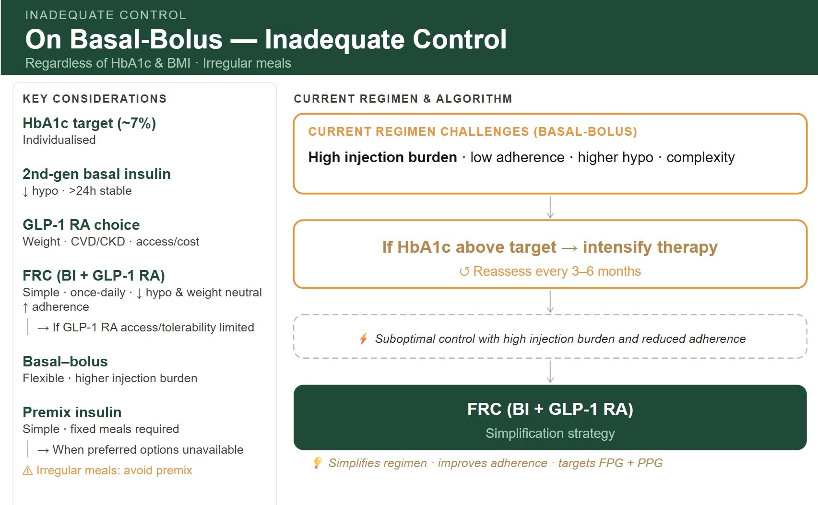
On Basal-Bolus - Inadequate control Regardless of HbA1c & BMI Irregular meal
CURRENT REGIMEN CHALLENGES (BASAL-BOLUS)
➤ High injection burden · low adherence · higher hypoglycemia · complexity
➕IF HBA1C ABOVE TARGET➔ Intensify therapy
(Reassess every 3–6 months)
WHY: Suboptimal control with high injection burden and reduced adherence
→ Transition to FRC (BI + GLP-1 RA) where accessible (simplification strategy)
💡 Simplifies regimen · improves adherence · targets FPG + PPG
🔹 Key Considerations
🧪 HbA1c target (~7%): Individualized
💉 2nd‑gen basal insulin:↓ hypo · >24h stable
⚖️ GLP‑1 RA choice: → Weight · CVD/CKD · access/cost
🔗 FRC (BI + GLP‑1 RA): Simple · once daily · ↓ hypo · weight neutral · ↑ adherence → Consider when GLP‑1 RA access or tolerability is limited
🔄 Basal–bolus: Flexible · higher injection burden
⚖️ Premix insulin: Simple · fixed meals required → Alternative when preferred options are unavailable
⚠ Irregular meals: avoid premix
Notes:
premixed insulins require regular meal timing and cause hypoglycemia and weight gain

Slide 64
Premixed vs. Basal-Prandial: When to Use?
Premixed Insulin
Basal-Prandial (BB/B+)
PREFER WHEN: ✔ Structured meal routines ✔ Simplicity & accessibility (public/primary care) ✔ HbA1c ≥2% above target with elevated FPG + PPG when FRC unavailable ✔ Naive patients with high PPG levels ✔ 30% of experts prefer as 2nd choice after BI CHALLENGES: ✘ Lacks dosing flexibility ✘ Hypoglycemia with irregular meals ✘ Difficult titration; may need twice-daily ✘ May need switch to bolus after 6 months
PREFER WHEN: ✔ Irregular meal schedules needing flexible dosing ✔ Individualized dose adjustments required ✔ After failure on basal/FRC despite optimization ✔ Frequent glucose monitoring capability
CHALLENGES: ✘ Low adherence: multiple daily injections ✘ Increased hypoglycemia and weight gain risk ✘ CGM often impractical/costly in community settings ✘ High regimen complexity
64

Slide 65
“Not available” covers: Lack of supply Cost barriers Access issues/ Reimbursement constraints

